Slide 1
Europe – A question of values A new educational game

Slide 2
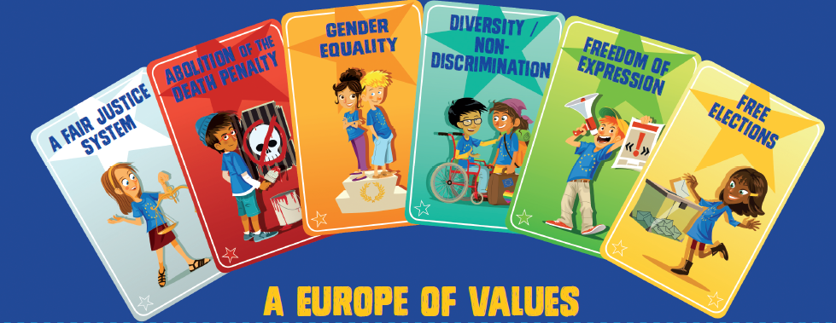
EUROPE – A QUESTION OF VALUES
A NEW EDUCATIONAL GAME
A new educational game
Aim
To teach pupils more about Europe’s shared values, illustrating the three fields of action of the Council of Europe: human rights, democracy and the rule of law.
The six values selected are:
freedom of expression
a fair justice system
gender equality
abolition of the death penalty
free elections
diversity/non-discrimination

Slide 3
EUROPE – A QUESTION OF VALUES
A NEW EDUCATIONAL GAME
Presentation
The brochure includes a board game for pupils aged 8–12 (end of primary/ start of secondary school) and useful information for teachers.
Objective
Pupils can have fun taking part in team challenges and discussing all the issues while testing their knowledge of democracy and human rights.
This is a great opportunity to combine classroom play activity with discussion about the core values that enable us to live together in society.

Slide 4
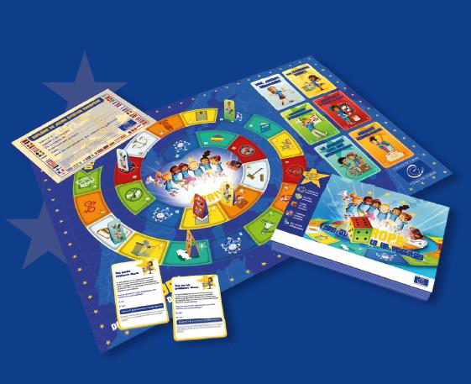
EUROPE – A QUESTION OF VALUES
A NEW EDUCATIONAL GAME
Specifications
The game includes:
1 board for use by the class (A1 poster format)
48 cut-out cards
6 playing pieces
1 make-it-yourself dice
1 diploma
a glossary and some advice for teachers.

Slide 5
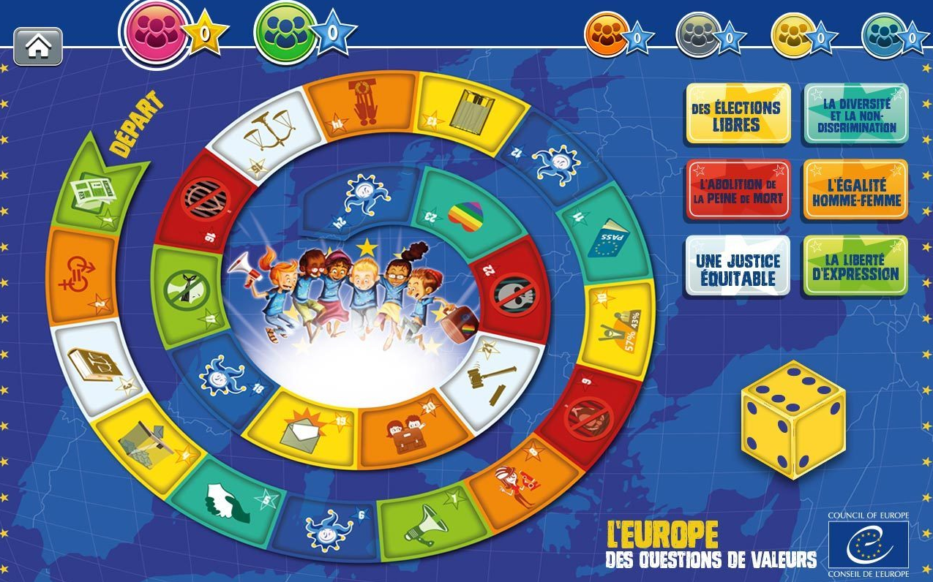
EUROPE – A QUESTION OF VALUES
A NEW EDUCATIONAL GAME
Versions
Printed versions:
Available in French (January 2016) English and German (April 2016)
Digital versions:
Available in March
* play online on classroom projection screen
* download the files
* USB key version

Slide 6
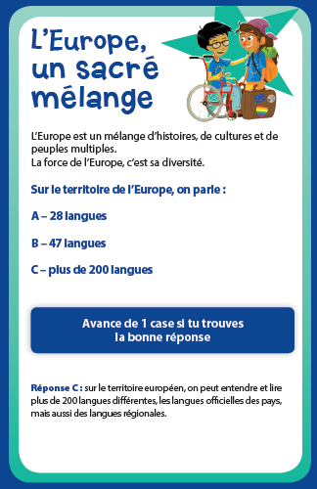
EUROPE – A QUESTION OF VALUES
A NEW EDUCATIONAL GAME
Relevance
Content validated by the Council of Europe
Easy to use (1½ hour activity in class, all included in one brochure)
Tested in classes with very positive feedback on the experience and relevance
Starting points for additional discussions in class (glossary and advice for teachers included)
Practical format (handy size/easy to produce and disseminate)

Slide 7
EUROPE – A QUESTION OF VALUES
A NEW EDUCATIONAL GAME
Possible co-operation
in members states
To be translated into the languages of other member states and into minority and regional languages
Print version – to be produced and disseminated in schools at national and / or regional levels (unit cost less than €2)
Digital version – to be produced and promoted at national / regional levels (production cost after translation: €1000)

