Slide 1
Freedom(s) – Learning activities for secondary schools on the case law of the European Court of Human Rights

Slide 3
Human rights for young people
learning “about” democracy and human rights
know their human rights and understand the conditions they depend upon;
learning “through” democracy and human rights
understand how to exercise human rights and to respect the rights of others;
learning “for” democracy and human rights
have the skills to be confident and willing to exercise human rights, with a sense of responsibility towards others and their community

Slide 4
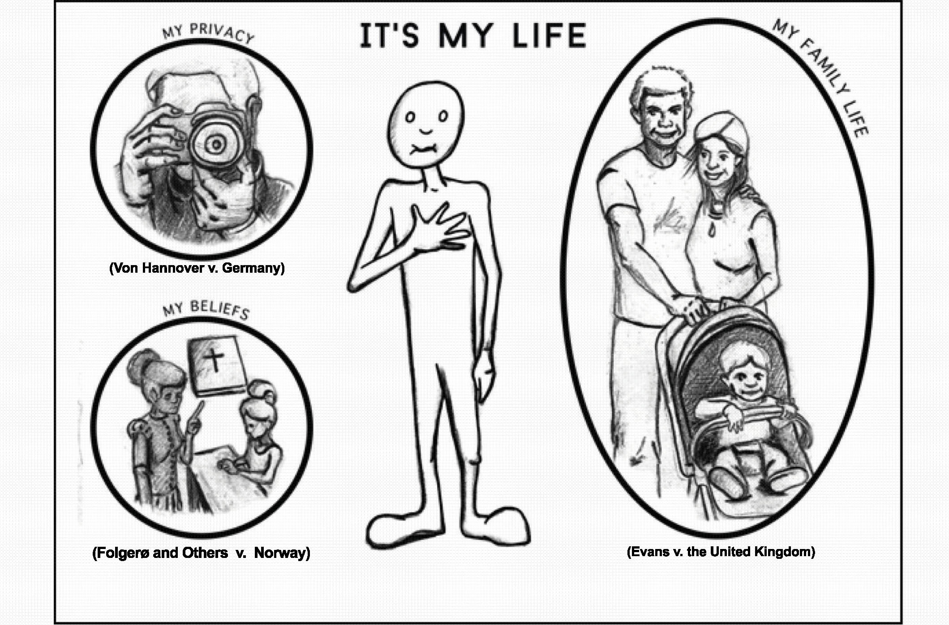

Slide 5
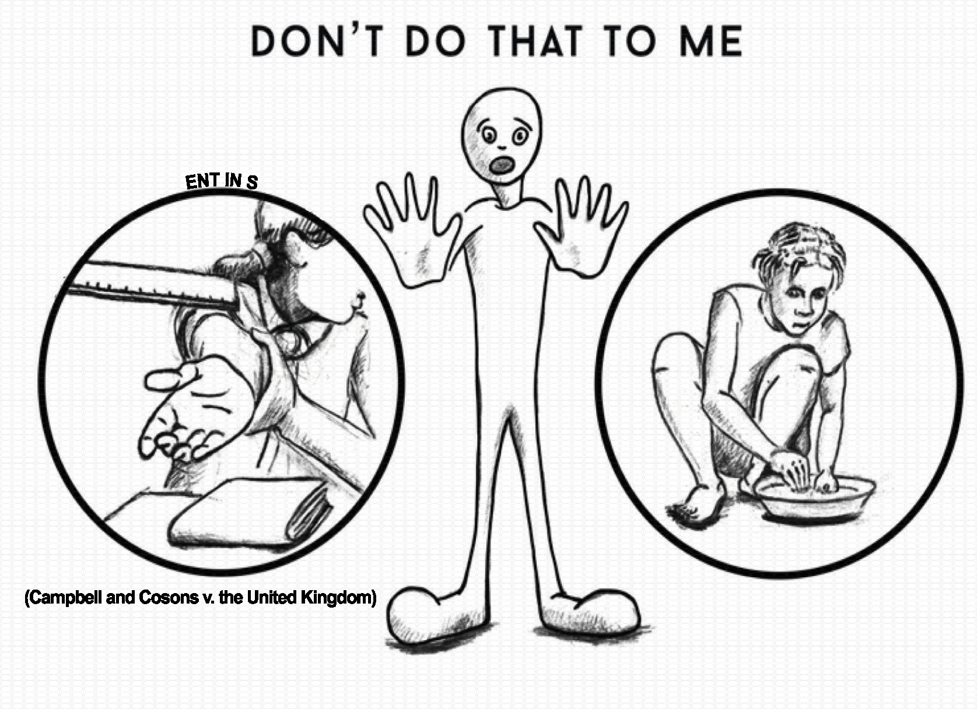

Slide 7
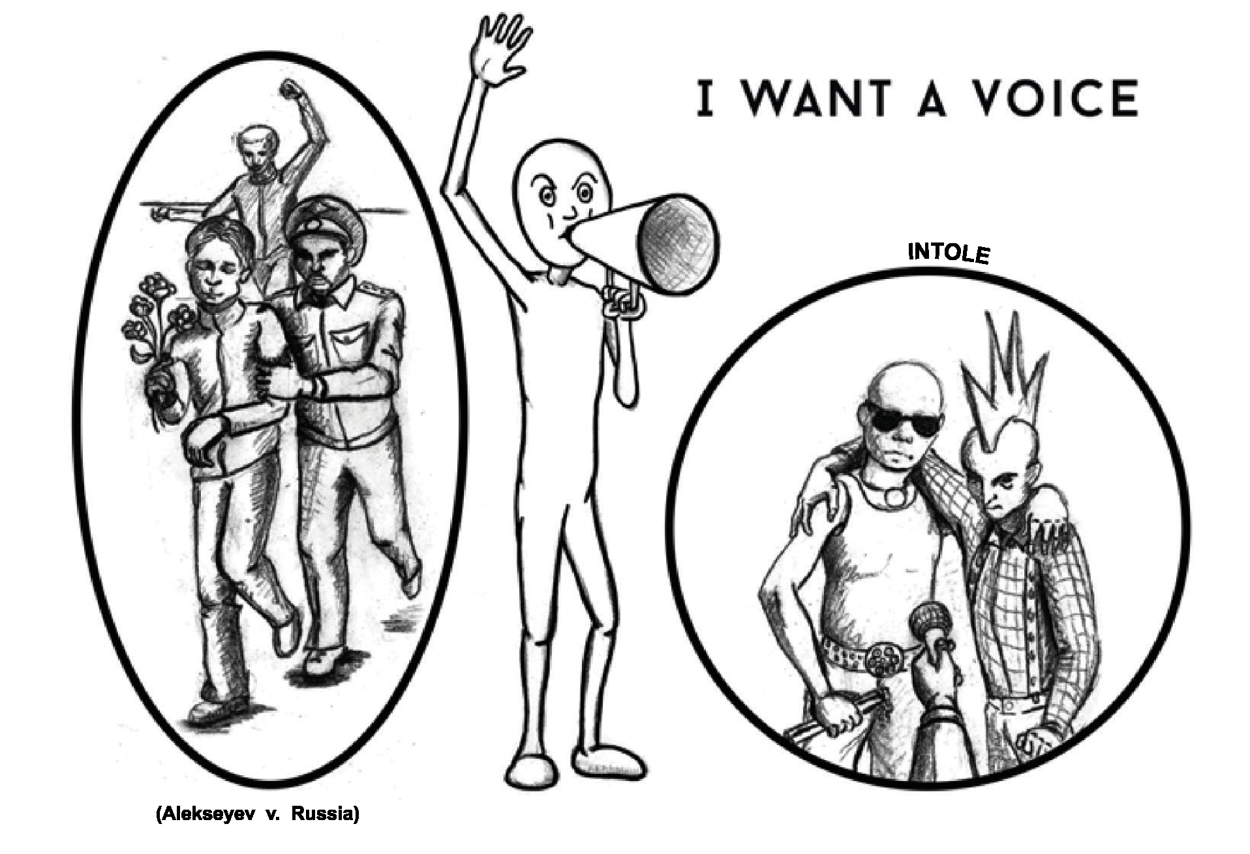

Slide 8
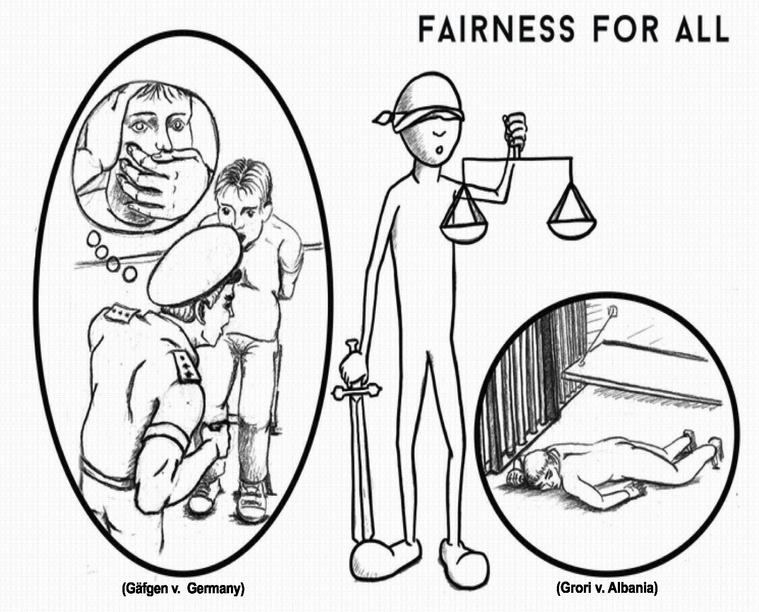

Slide 9
Introducing the cases
the facts;
the legal challenge:
the response from the Strasbourg Court;
what happened next, e.g. the impact of the Court’s decision on national law

Slide 10
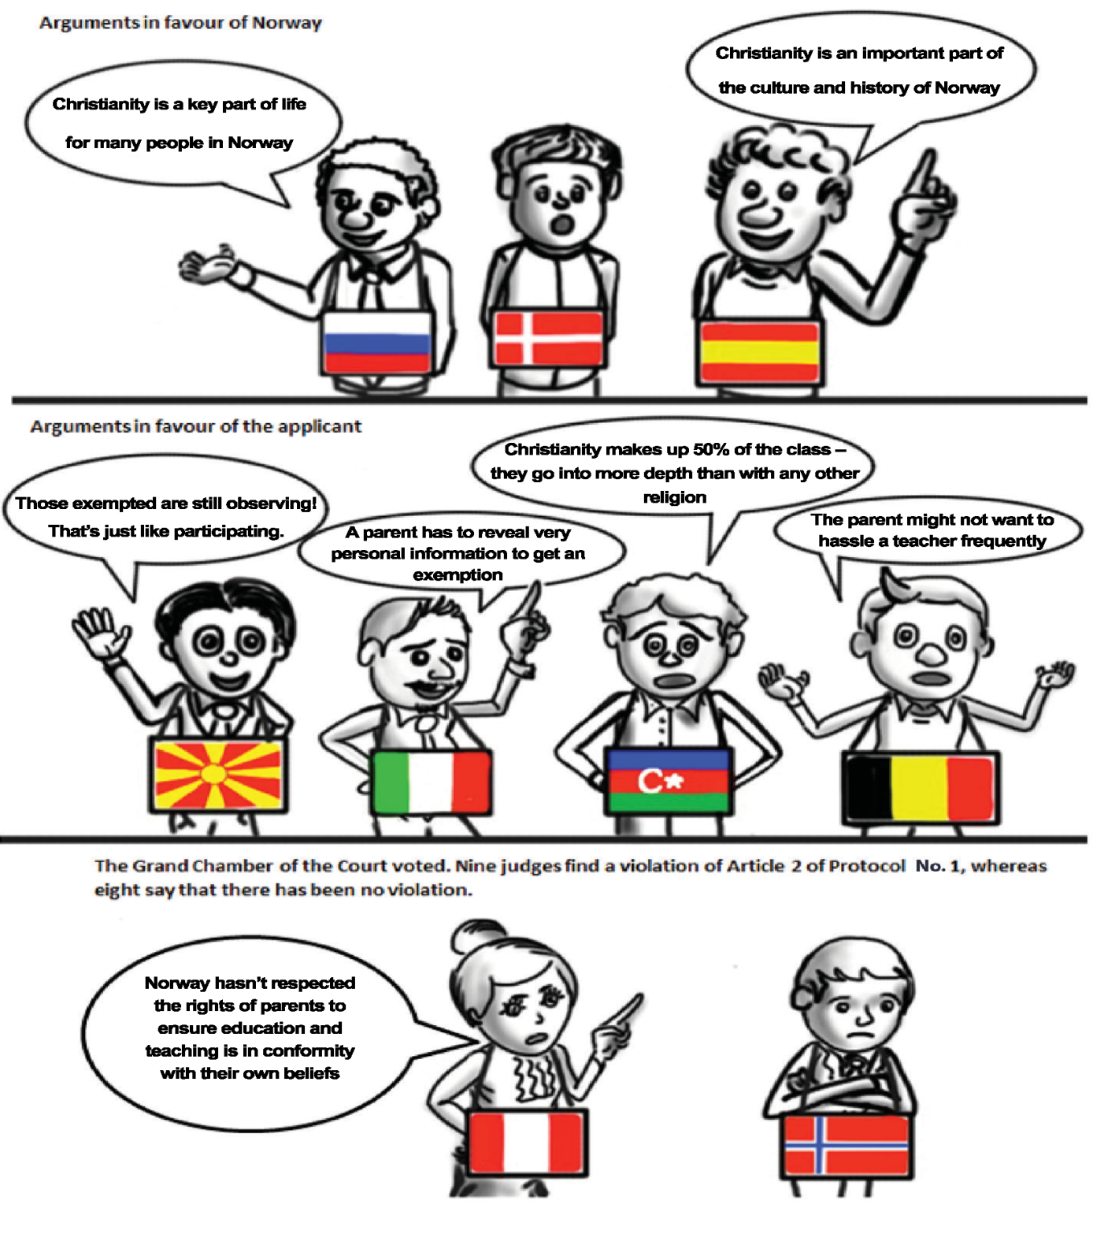

Slide 11
Learning activities
the concepts and topics involved;
the learning objectives;
the activity plan
guidelines on how to organise the 45-minute activity in terms of method, teacher activities and student activities;
pedagogical support material

Slide 12
In short…
How each of us can make a difference;
Why each of us should try to make a difference

