Slide 1
UN Women in Europe and Central Asia
Ingibjorg Gisladottir
Regional Director for
Europe and Central Asia
April 2016

Slide 2
Our Unique Mandate
Lead agency on Gender Equality and Women’s Empowerment
Working across the three pillars of the UN
Political
Development
Humanitarian
Key coordination role in the UN system
Supporting normative and policy frameworks

Slide 3
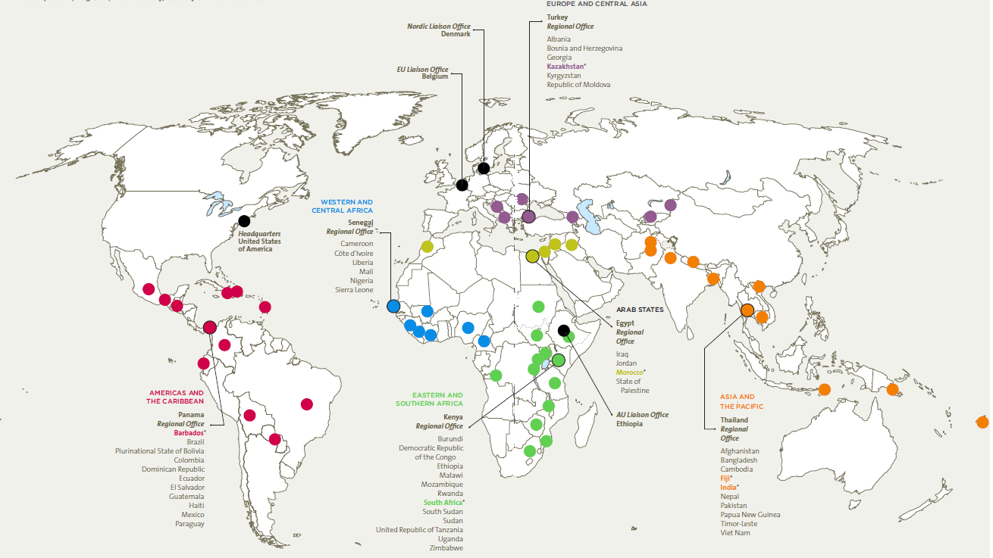
UN Women in the World

Slide 4
Europe & Central Asia Regional Office
Established in Istanbul in January 2014
Transitioned from 2 sub-regional offices: in Kazakhstan and Slovakia
Supporting 14 countries in the region
UNW in the region: 1 multi-country office, 5 country offices and 5 programme offices

Slide 5
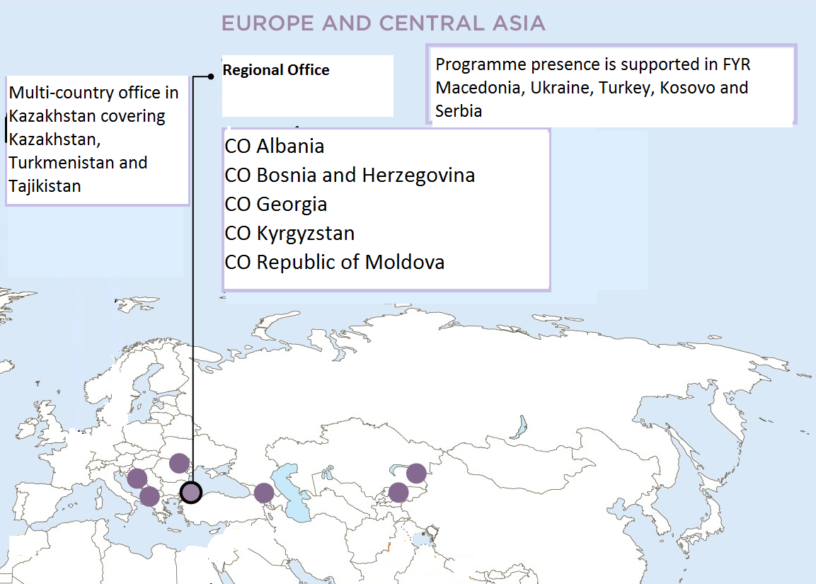
Europe and Central Asia Region
Multi-countrty office in Kazakhstan covering Kazakhstan, Turkmenistan and Tajikistan
Programme presence is supported in Kosovo, fYR Macedonia, Serbia, Turkey and Ukraine

Slide 6
UN Women Impact Areas
Governance and national planning reflect gender equality commitments and priorities
Women lead and participate in decision-making at all levels.
Strategic Plan on GE/WE
Global norms, policies and standards on GE&WE are in place and applied through action by Governments and other stakeholders
Women and girls live a life free from violence
Women are economically empowered and benefit from development
Peace and security and humanitarian action are shaped by women’s leadership and participation

Slide 7
CoE Gender Equality Strategy
Combating gender stereotypes and sexism
Preventing and combating violence against women
Gender
Equality
Strategy
Guaranteeing equal access of women to justice
Achieving gender mainstreaming in all policies and measures
Achieving balanced participation of women and men in political and public decision-making

Slide 8
Women in the region: A challenging context
Conflict
Unresolved and active conflicts result in large numbers of women refugees and internally displaced, humanitarian crisis, obstacles to economic development, tourism, trade and access to rights.
Social Norms and Traditions
Growing conservatism reinforcing discriminatory gender stereotypes
Laws Framework & Practices
Strong normative gender equality frameworks but large implementation gaps:
Lack of access to services, information & resources
Lack of access to justice
VAWG
Economic & political environment:
Lack of political will for change,
Growing financial crises,
Underrepresentation in women’s political and economic participation, depleted natural resources, natural disasters, and migration (women left behind without access to remittances)
Weak national GE mechanisms (national gender machinery)
Measuring Progress
Gaps remain in sex disaggregated data and gender sensitive indicators

Slide 9
Strategic Regional Partnerships
Bilateral: Sida, SDC, ADA, EU, Norway, DFiD, Finland, etc.
European Union
Organiziation for Security and Cooperation in Europe (OSCE)
UNECE
Council of Europe (CoE)
CIVIL SOCIETY
Civil Society Advisory Group (CSAG)
Outcomes for
WOMEN
National gender machineries
Private
sector
UN Women National Committees in the region

Slide 10
Emerging Priority: Refugees
OUR CONCERNS
Women and girls are not getting appropriate gender sensitive services and support – e.g. to address sexual and gender based violence and in support of pregnant women
First responders don’t have the capacities to identify women’s vulnerabilities and respond to them
Family reunification is increasingly limiting – having devastating effects on women who have been left behind
Women discouraged from making individual asylum applications - don’t have access to female interpreters and childcare during review of their applications
MORE GENDER SENSITIVE ASYLUM AND AID POLICIES ARE NEEDED

Slide 11
Emerging Priority: Refugees
WHAT WE HAVE DONE
Gender assesment of the refugee and migrant crisis in FYR Macedonia and Serbia
Distribution of non-food items (hats, scarfs, shirts, socks, shoes etc.) in collaboration with Oxfam.
Identifying gaps in response to women and girl refugees in Turkey
Strategy meeting of CSOs working with Women on the Move, fleeing conflict in Syria and Iraq 16-18 May

Slide 12
UN Women and CoE cooperation:
Map availability and accessiblity of support services for women & girls subjected to GBV in 5 CoE member states (Albania, BiH, FYR Macedonia, Georgia, Turkey)
2 more studies, supported by the Regional Office, are currently finalized in Serbia and Montenegro and CoE is initiating a similar study in Kosovo.
A proposal is being finalized on a multi-country project which would repeat the study in 7 countries to see if there’s been any progress after the baseline study.

Slide 13
UN WOMEN–EU: Partners for Progress
MULTI-COUNTRY Programme: Ending violence against women in the Western Balkan Countries and Turkey INSTRUMENT FOR PRE-ACCESSION ASSISTANCE (IPA II) 2016-2019
Implementing Norms, Changing Minds: A regional intervention in Turkey and six Western Balkan countries on women's human rights and ending violence against women, targeting the most disadvantaged groups of women and addressing harmful gender stereotypes.
Participating countries: Albania, Bosnia and Herzegonica, Kosovo, FYR Macedonia, Montenegro, Serbia and Turkey

Slide 14
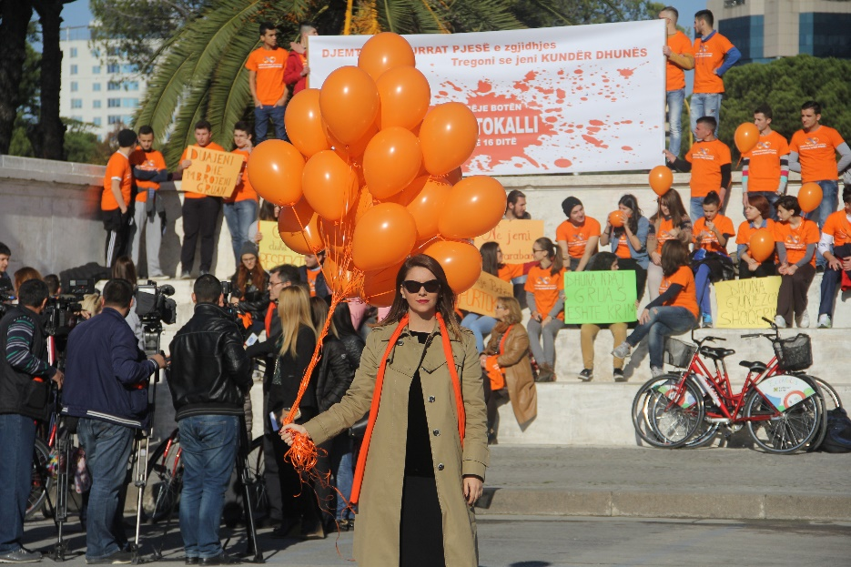
CoE as a Partner for Progress
New programme = new opportunity for collaboration
Focusing on preventing and combating violence against women and combating gender stereotypes and sexism
Narrowing the gap between standards and their implementation:
Engaging in regional dialogue and knowledge-sharing on Istanbul Convention and CEDAW
Regional expert working group on the inter-sectionality of inequalites and discrimination

Slide 15
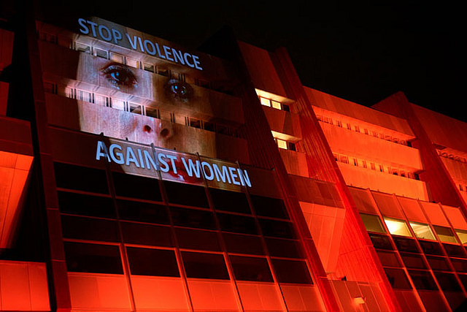
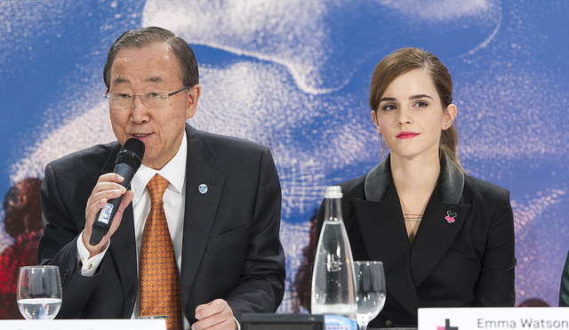
CoE as a Partner for Progress
Promoting favourable social norms and attitudes to promote gender equality and prevent discrimination of and violence against women:
HeForShe Campaign
UNiTE Campaign

Slide 16
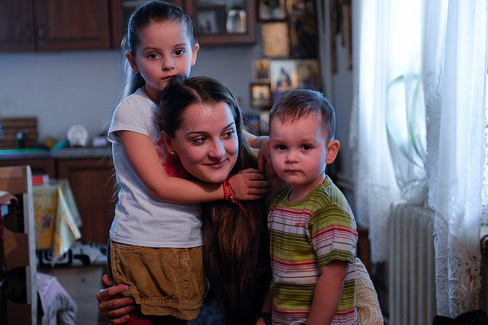
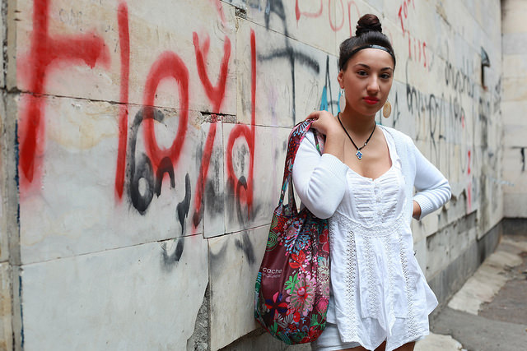
CoE as a Partner for Progress
Empowering women & girls that experienced discrimination or violence to advocate for and use available, accessible and quality services:
Engaging in evidence-based regional advocacy initiatives as follow-up to the multi-country study
Finalization of a framework to measure women’s access to justice

Slide 17
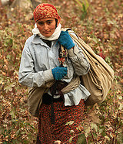
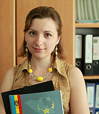
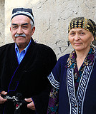
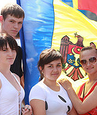
Thank You
Ingibjorg Gisladottir
Regional Director for
Europe and Central Asia
April 2016

