Slide 2
INDICATOR FRAMEWORK ON CULTURE & DEMOCRACY (IFCD)
Helmut K. Anheier, President & Dean
Matthias Haber, Research Scientist
Hertie School of Governance

Slide 3
“Quantifying culture’s role in development processes is a conceptual minefield.”
UNESCO’s “Culture for Development Indicators” Website
http://www.unesco.org/new/en/culture/themes/cultural-diversity/diversity-of-cultural-expressions/programmes/culture-for-development-indicators/seven-dimensions/
accessed 1. October 2014

Slide 4
Origins
Council of Europe Conference of Ministers of Culture (2013):
Improving the effectiveness of cultural policies
Indicators on the impact of culture on democracy
Indicators on the economic efficiency of financing culture
Monitoring trends in European comparison
Special regard to access to, and participation in, culture
IFCD: Provide European governments with an effective tool for policy making

Slide 5
Purposes
Assemble indicators on culture and democracy and the economic efficiency of financing culture that provide a stronger evidence base for policymaking
Enable policymakers to examine their own position in terms of culture and democracy and in comparison with other countries
Contribute information to Council of Europe reports and projects and to relevant initiatives by other international and national bodies

Slide 6
Progress to Date
2013 Initial Scoping Study
2014 Framework Development
Developed conceptual framework & practical model
Consulted with project advisors*
Populated framework with available data
Tested for selected countries & hypotheses
Presented framework & results
2015 Further Development
Expanded framework
Populated framework with additional data
Explored policy relationships
Developed proposal for an interactive interface
2016 Preparing to Launch
Country visits to 10 countries test the IFCD
Created a policy makers’ guidebook
Developed prototype and then beta version of interactive, web-based interface
*P. L. Sacco & G. Ferilli, Institute of Arts, IULM University; P. Inkei, The Budapest Observatory; P. Kern, KEA; A.Wiesand, European Institute for Comparative Cultural Research (ERICarts)

Slide 7
The General Framework

Slide 8
The General Framework
What’s innovative?
Detailed, semi-parallel constructs for culture and democracy
Process perspective (input -> throughput -> output)
Policy action focus (identifying “levers” for change, policy intervention)
Multiple layers to assess where a country stands
Multilevel data collection

Slide 9
Structure of the Framework
Culture
Policy
Economic
Freedom & Equality
Civic
Cultural Funding
Cultural Funding Legislation
Direct Funding of Culture
Cultural Openness
Cultural Education

Slide 10
Structure of the Framework
Democracy
Policy
Rule of Law
Freedom & Equality
Civic
Political Participation
Institutionalised Participation
Non-Institutionalised Participation

Slide 11
Variables
 | Components | Indicators | Variables
Culture | 7 | 18 | 86
Democracy | 10 | 23 | 91
Total | 17 | 41 | 177
Based on a comprehensive review of academic literature
All data are collected at various levels but aggregated to the national level

Slide 12
Civic dimension
DIMENSION | COMPONENTS/INDICATORS | DIMENSION | COMPONENTS/INDICATORS
Civic | Cultural Participation Artistic expression and creation Interest in foreign cultures Non-partisan involvement Online creativity Online cultural participation Passive cultural participation Students in the arts | Civic | Political Participation Institutionalised participation Non-institutionalised participation

Slide 13
Policy dimension
DIMENSION | COMPONENTS/INDICATORS | DIMENSION | COMPONENTS/INDICATORS
Policy | Cultural Funding Cultural funding legislation Direct funding of culture Cultural Openness Support and promotion of cultural diversity Cultural Education Arts education Intercultural education | Policy | Government Capability Analytical capacity Central bank independence Confidence in political institutions Political independence Political Competition Political competitiveness Political party finance Rules for contestation and competition Safeguards & Checks & Balances Constraints on government powers Judicial review Transparency Absence of corruption Informational openness

Slide 14
Economic / Rule of Law dimension
DIMENSION | COMPONENTS/INDICATORS | DIMENSION | COMPONENTS/INDICATORS
Economic | Cultural Industries Cultural industry outputs Intangible assets Size of the cultural industry Cultural Infrastructure Size of the cultural infrastructure | Rule of Law | Equality Before the Law Judicial impartiality Judicial independence Quality of the Legal System Confidence in the justice system Judicial efficiency and professionalism

Slide 15
Freedom and Equality dimension
DIMENSION | COMPONENTS/INDICATORS | DIMENSION | COMPONENTS/INDICATORS
Freedom & Equality | Cultural Access and Representation Access to cultural sites and events Public Measures for equality | Freedom & Equality | Freedom of Freedoms Freedom and neutrality of the press Freedom of association Freedom of expression Individual Liberties Free conduct of life Security and physical integrity Political Representation Equality of participation

Slide 16
Methodology
Identify ideal variables
Seek sources and collect data
Sort out variables for which there was data for less than 50% of the countries (many variables come from EU sources that do not include non EU member states)
Include (for now) countries with greater than 50% coverage of remaining variables

Slide 17
Member State Coverage
37 Council of Europe member States with data for at least 50% of the variables
Albania | Finland | Macedonia | Slovenia
Austria | France | Malta | Spain
Belgium | Germany | Moldova | Sweden
Bosnia & Herzegovina | Greece | Netherlands | Switzerland
Bulgaria | Hungary | Norway | Turkey
Croatia | Ireland | Poland | Ukraine
Cyprus | Italy | Portugal | United Kingdom
Czech Republic | Latvia | Romania
Denmark | Lithuania | Serbia
Estonia | Luxembourg | Slovakia

Slide 18
IFCD: For Whom?
Policy makers
basis for evidence based decision/policy-making
Ready comprehensive framework to identify and monitor national cultural strategy goals
Researchers
hundreds of data points to play with and test hypotheses
aggregated indices can be used as a basis for future research
NGOs
basis for evidence-based grant proposals and advocacy tools
Identification of areas and actors to improve collaboration
Cultural practitioners
all information in one place
basis to better understand culture, its components and involved actors

Slide 19
Using the IFCD
The policy maker’s guidebook
Testing relationships
Assessing your country’s status
Detailed appendix with variables and sources
Examples of uses
Outlines key framework elements

Slide 20
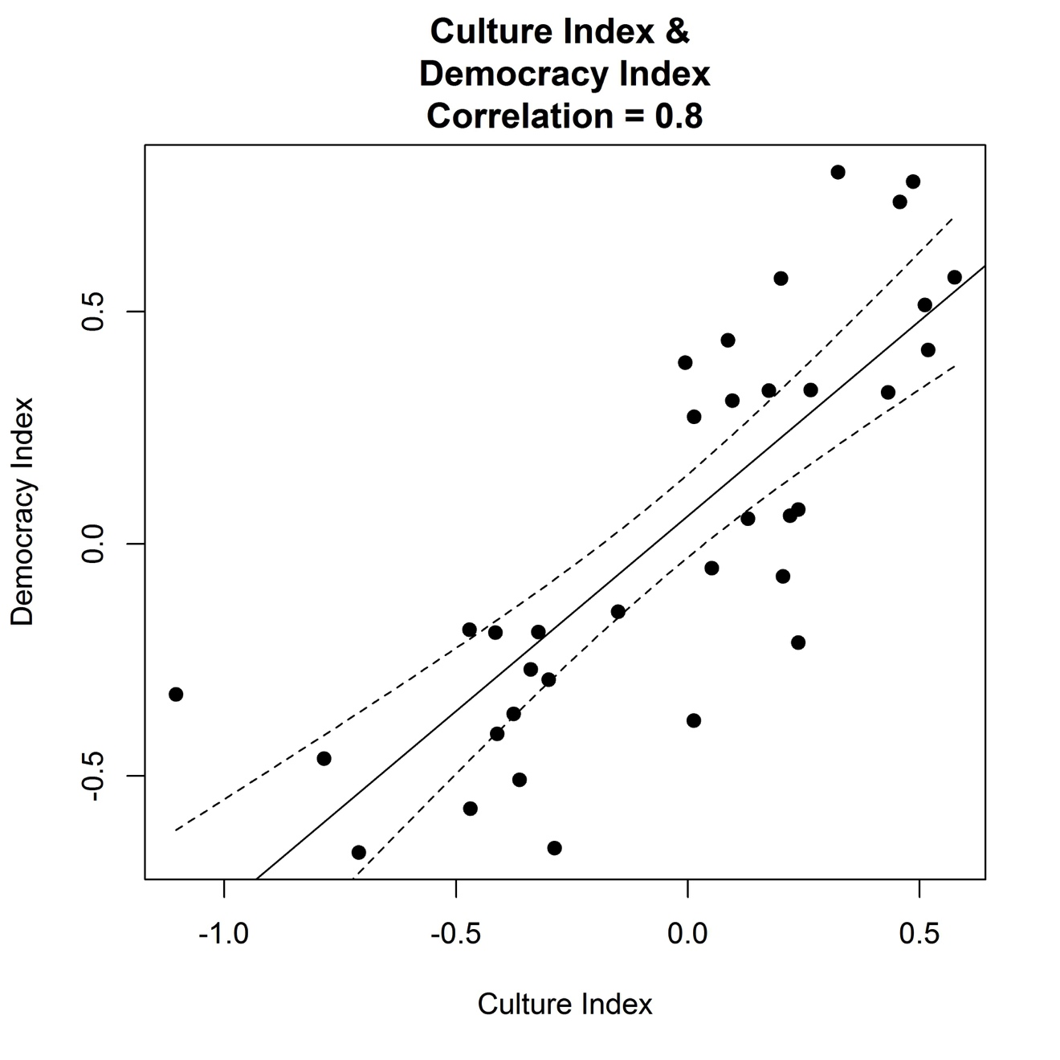
Testing Relationships using IFCD
Combining domains, components and indicators within the IFCD

Slide 21
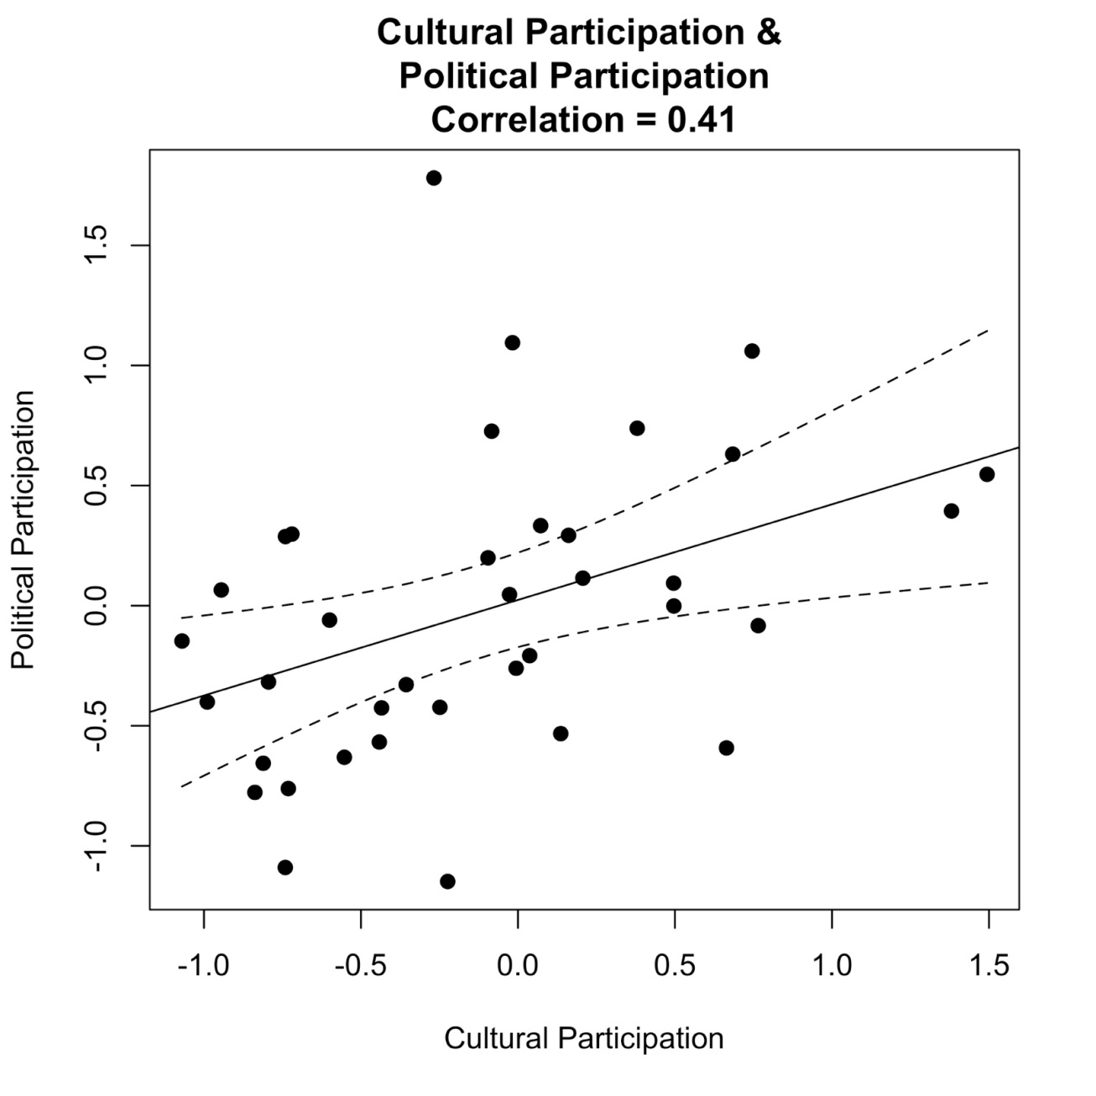
Testing Relationships using IFCD
Combining domains, components and indicators within the IFCD

Slide 22
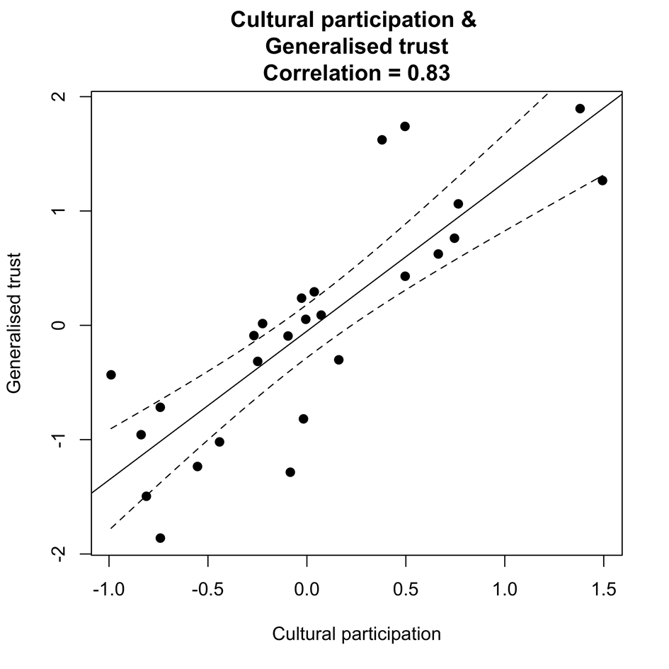
Testing Relationships using IFCD
Combining IFCD components and indicators with external data

Slide 23
Interactive, Web-based Interface
Explore and analyse the data in the IFCD from multiple perspectives (Beta Version)
Country-specific exploration and comparison of performance on the many components and indicators that comprise the IFCD
Country-specific targeting of 'opportunity' for improvement on key components of culture and democracy
Relationship testing between culture and democracy components and indicators

Slide 24
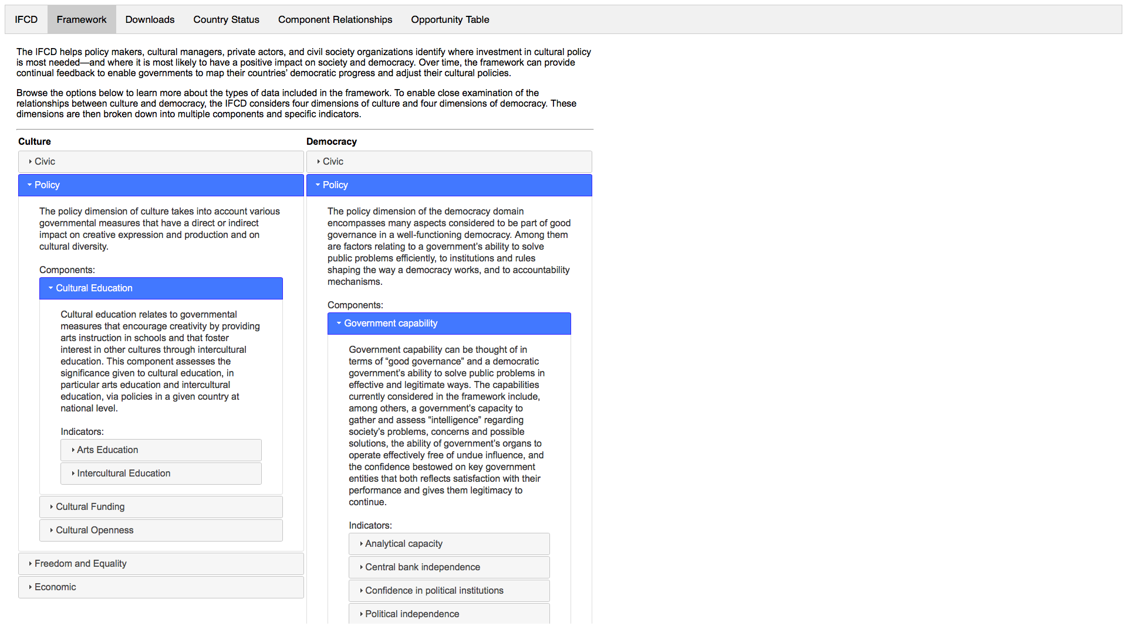
Interactive, Web-based Interface
Entire framework composition
shows composition of every domain
defines domains and indicators

Slide 25
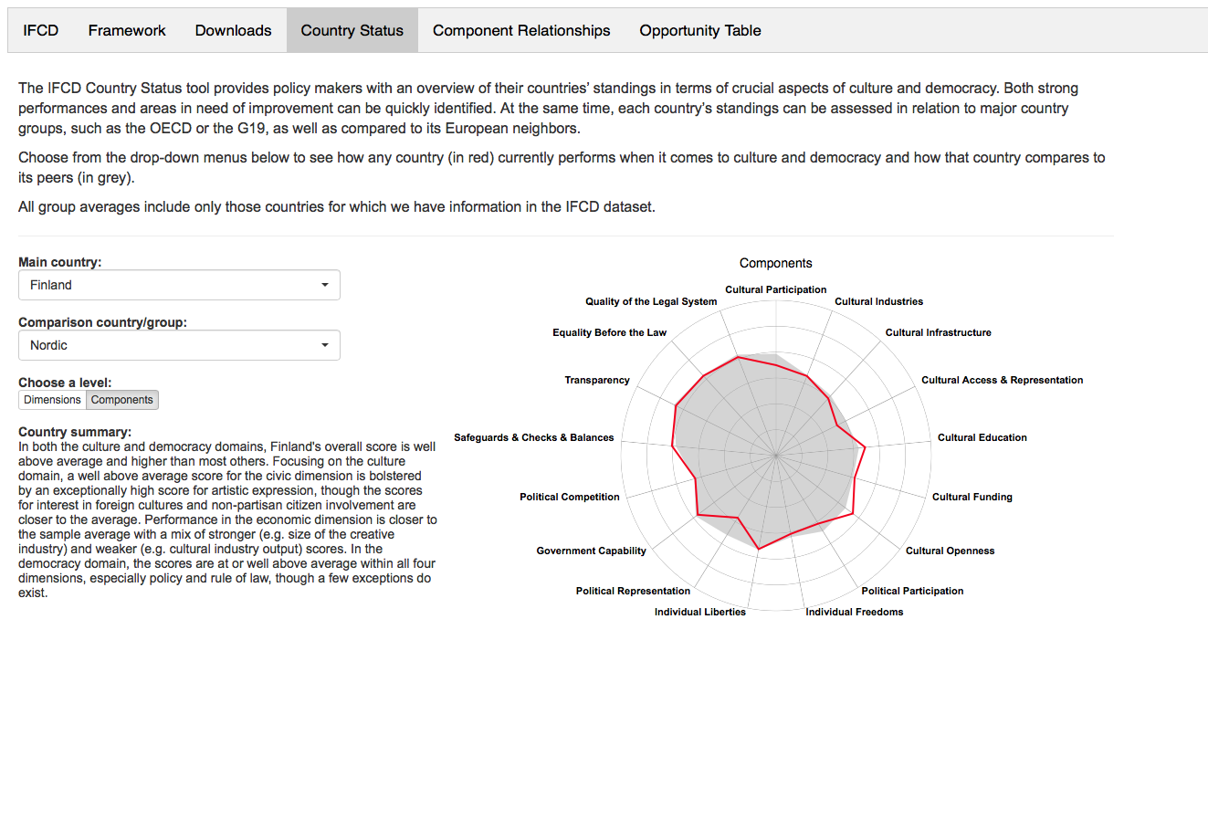
Interactive, Web-based Interface
Country Status
shows country’s performance on all components simultaneously
adapts to user choice of country, comparison group, and depth in the framework

Slide 26
Interactive, Web-based Interface
Opportunity Table
innovative opportunity score to target potential areas for improvement
accounts for relationship between components and room for improvement in performance

Slide 27
Interactive, Web-based Interface
Component Relationships
tests relationships between components and indicators
identifies a chosen country‘s placement within the plot

Slide 28
IFCD Value-added
Takes culture out of a blind spot and brings it to the frontline of policy-making
Monitors trends at European level
Allows identification of countries with excellent performance in certain areas to inquire and learn more about best practices
Encourages evidence-based dialogue

Slide 29
Country Visits
Key feedback from experts in Belgium, Croatia, Finland, France, Germany, Italy, Poland, Serbia, Sweden and Switzerland:
Add, drop or re-think certain variables and indicators
Consider implications of federal vs. unitary government structures
Examine ways to gather or incorporate data from non-EU countries
Identify key variables and work with country partners to ensure monitoring over time
Examine ways to gather and incorporate nationally available data

Slide 30
Next Steps
Data
Monitor trends across time
Establish system and processes for updating data regularly
Develop harmonised data collection instruments
Interact with statistical agencies and survey institutes to add additional data

Slide 31
Next Steps
Interactive interface
Assemble feedback from users on beta version of the interactive interface
Implement changes
Work with country partners to “personalise” country summary inputs
Create a dedicated website for the interface with additional materials and functions

Slide 32
Next Steps
Reports and Case Studies
Prepare input for reports by the Council of Europe and European Commission leadership
Create annual thematic reports
Work with country partners to create detailed country reports
Further develop the framework and explore additional uses

