Slide 1
Klaus Heusslein EGLSF Co-President
Stereotypes and Discrimination in sports environments LGBT Stereotypes in Sport – ways to remove Stereotypes based on sexual orientation and/or gender identity

Slide 2
STEREOTYPES
The term stereotype comes from the Greek words στερεός (stereos), "firm, solid” and τύπος (typos), "impression”, with other words "solid impression".
Stereotypes, prejudice, and discrimination can be seen as related but they have different concepts: Stereotypes often occur without conscious awareness, while prejudice and discrimination are forms of behaviour.

Slide 3
STEREOTYPES
Because stereotypes simplify and justify social reality, they have potentially powerful effects on how people perceive and treat each other.
As a direct result, stereotypes can lead to discrimination in sports environments and other domains.
Some typical examples:
People from Nordic countries are blond / blue eyes
Italians eat mostly pizza and pasta
Germans consume beer, sausage and sauerkraut

Slide 4
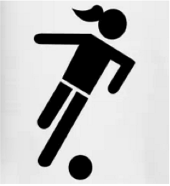
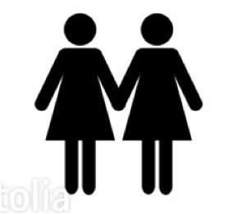
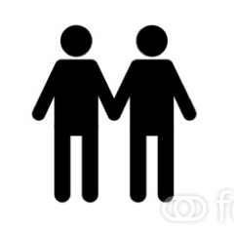
STEREOTYPES
female football players are lesbians
gay men don’t play football

Slide 5
STEREOTYPES
Stereotypes often occur without conscious awareness.
What can we do to remove stereotypes ?

Slide 6
STEREOTYPES
What can we do to remove stereotypes ?
DEMONSTRATION
EDUCATION

Slide 7
Education
is the key to remove stereotypes
Klaus Heusslein EGLSF Co-President

Slide 8
Thank you for your attention!
Klaus Heusslein EGLSF Co-President
Education is the key to remove stereotypes!

