Slide 2
Countering extremism through exchanging research, policy & practice
Counterextremism.org is an online vehicle for the exchange and dissemination of best practices and lessons learned in countering extremism and radicalisation at a local, national and international level.
©2014 Institute for Strategic Dialogue

Slide 6
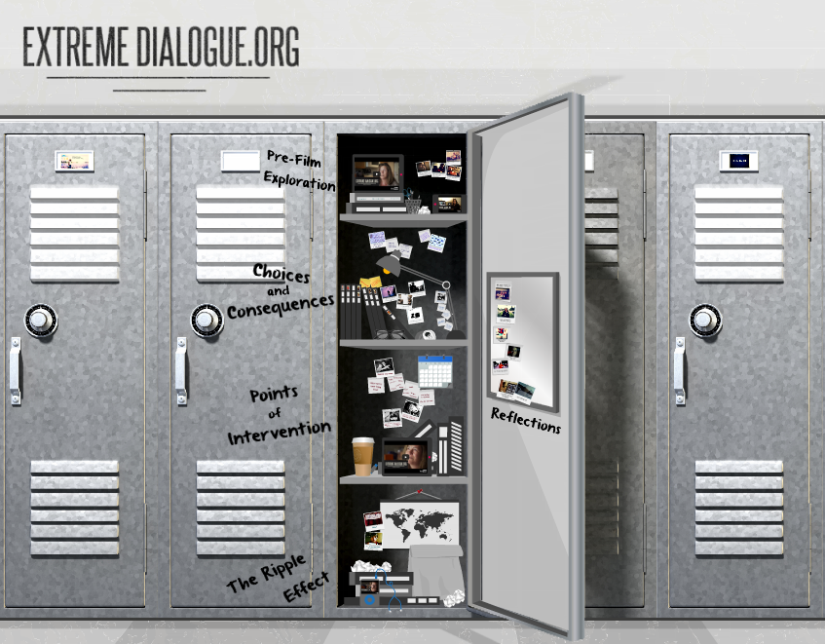
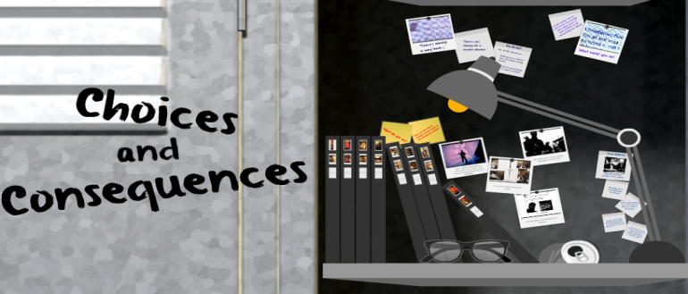
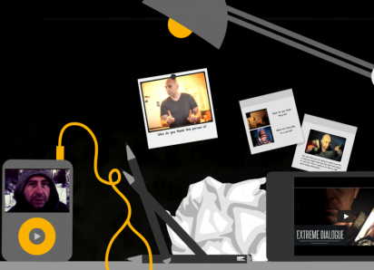

Slide 8
1st Week of Campaign – Online
4460 sessions
3707 users
21,657 page views
4.86 average pages per session (6 pages in total)
+50,000 views
175,000 minutes viewing time
3:30 min average viewing time
95% of views in Canada
80.5% of viewers under 25
Posts reaching over 210,000 people
+1,100 likes (73% from Canada)
1,800 ‘engagements’ (users that click on or interact with posts)
237 followers
290 retweets
207 mentions

Slide 9
1st Week of Campaign – Media Coverage
Over 250 stories have featured Extreme Dialogue across television, radio, print and online media platforms

