Slide 1
EDC/HRE Case of Georgia
Strasburg, November 14-15, 2016

Slide 2
Content
How it has started
Trainers and participants
Strategic line
Results according HEIs
Result of synergy
Multifold transformation
The way ahead

Slide 3
How it has started?
Democracy is like a bicycle, if you stop spinning its wheels it will fail.

Slide 4
Trainers & Participants
Trainers
Olena STYSLAVSKA & Marzena RAFALSKA
Participants:
15 representatives of 8 HEIs + 15 representatives of school society = 30 educators
And
Natia, who is very special in connecting people and making them to do their best.

Slide 5
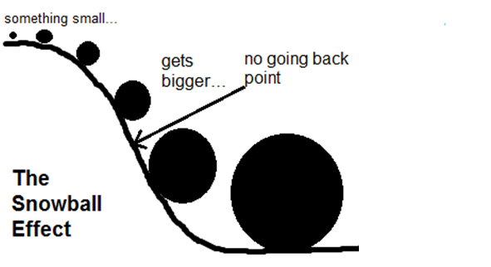
Strategic line
Involvement of HEI representatives and setting long-term plans: prepare future teachers to achieve snowball effect
10 new/updated
accredited courses

Slide 6
Results according HEIs

Slide 7
Iakob Gogebashvili Telavi State University - leading university in the East of Georgia
New course Principles of Education for Democracy was developed for teacher training 60 credit education program. The program is already accredited.
New five-credit course and syllabus for integrated educational program for primary education is ready for program accreditation.
The development of new training module is underway and will be completed in the nearest future.

Slide 8
Ilia State University – leading university located in the capital of Georgia
Intercultural Education – Pedagogical Approaches, new 5 credit BA compulsory course for teacher training program.
Multiethnic and Multicultural Georgia, new five-credit BA compulsory/elective course for teacher training program.
Citizenship Education at Primary, Basic and High School, three 5 credit updated courses for BA, MA and teacher certification programs.
Training module “School and Intercultural Education”, series of trainings has been already launched: first on 24th of September, second on 6th of November. 120 teachers are involved.
Scientific and popular articles: based on new knowledge and experience several articles were prepared and published in online newspaper Mastsavlebeli (http://mastsavlebeli.ge/) in 2015/16.

Slide 9
Samtskhe-Javakheti State University - leading university in the South of Georgia
New compulsory courses:
Education for Democratic Citizenship and Human Rights Education was developed for elementary school teacher training BA program.
Education for Democratic Citizenship and Human Rights Education was developed for middle and high school teacher training BA program.
The program has successfully went through the accreditation procedures.

Slide 10
Batumi Shota Rustaveli State University – leading university in the west of Georgia
Three new training modules on Education for Democratic Citizenship were approved by the Academic Council. The first training sessions were already been piloted in summer 2016.
New syllabi for teacher training programs were developed and are under the program accreditation process.

Slide 11
Shota Meskhia State Teaching University of Zugdidi – leading university in the west of Georgia
New elective course Education for Democratic Citizenship and Human Rights Education was developed and offered at BA level.

Slide 12
I. Javakhishvili Tbilisi State University - leading university located in the capital of Georgia
New course Intercultural Education was developed based on the principles of EDC/HRE for BA as well as MA level program.
In addition, a workshop for different discipline/subject teachers is planned in the Fall term of 2016-2017 academic year aiming at implementation of the principles of EDC/HRE by interdisciplinary approach in teacher training programs. The workshop aims to promote future teachers’ awareness on EDC/HRE together with subject content.

Slide 13
Result of synergy – HEI + School
Development of Students’ social and civic competences through club activities (Teaching Practice for Teacher Training Program Students)
Joint research (school + university) of practical needs of the school has been initiated. The research involves not only school administration, but also teachers, and as for HEIs it involves administration, academic staff and future teachers.
Such synergetic efforts will enable us to focus more on research of school problems and offer specific recommendations, findings, ways of improvement before the completion of the project.

Slide 14
Multifold transformation (Outcomes to date)
project results can be observed at different levels:
Transformation at the individual level
Transformation at the teaching/learning level
Transformation at the institutional level
Transformation at the society level

Slide 15
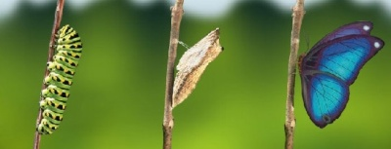
Transformation of Self

Slide 16
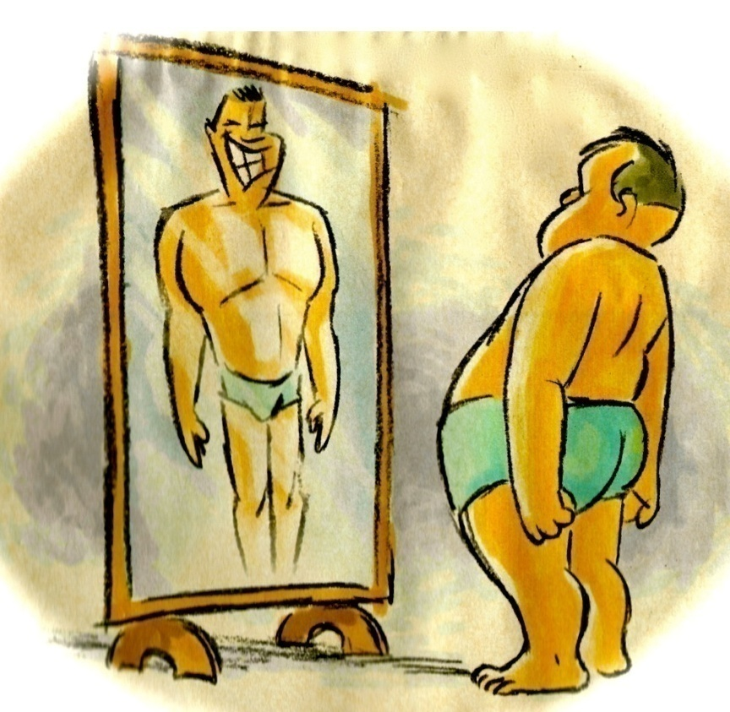
Transformation at THE ‘Self’ level
Be the change you want to see in the World
new knowledge
new skills
new people
new relationships
new approaches
new attitudes
new values
new perspectives
…………………..

Slide 17
Transformation of THE teaching/learning
Professionals equipped with new knowledge and skills at the individual level change the teaching/learning environment towards democratic vector.

Slide 18
The transformation at THE institutional level
New syllabi, training modules and programs were developed for in-service and future teachers, (some teachers already developed training modules in the format of interdisciplinary lessons.)

Slide 19
Transformation of THE Society
HEIs and kings.ge (organizer of Subject Olympiads at local level) perform joined efforts to organize the series of one-day training on democratic citizenship education in different regions of Georgia.
The new three-year ERASMUS+ project Curriculum Reform for Promoting Civic Education and Democratic Principles in Israel and in Georgia (CURE). It has started in October 2016.
Participants from Georgia: Ilia State University, Telavi State University, Batumi State University and Tbilisi State University.
Goal of the project: ensure successful curriculum reform and equip future teachers with knowledge and strategies for citizenship education of students.
Grant applicant is Israeli, while the Ilia State University is a coordinator from Georgian side.

Slide 20
The way of EDC/HRE is endless
and
efforts it requires are limitless,
but if we want to become a society we all dream for,
it is worth to do our best to make our dream true…

Slide 21
გმადლობთ!!!
Thank you!!!

