Slide 1
Grassroots Evaluation of Human Rights Implementation “How marginalised communities in Northern Ireland are assessing human rights change on the ground”
11th December 2015

Slide 2
“To enable the powerless, the invisible, to be part of making change....that changes how they see themselves. And that changes everything”
Inez McCormack, Founder of PPR

Slide 3
Campaigns Past and Present
Seven Towers Residents Housing Campaign
Mental Health Rights Group
Right to Work: Right to Welfare
Simon Community Homeless Project
Footprints Domestic Violence
Lower Shankill Regeneration Board (Play and regen.)
Rialto Rights in Action (Housing)
Girdwood Residents Jury (regeneration)

Slide 4
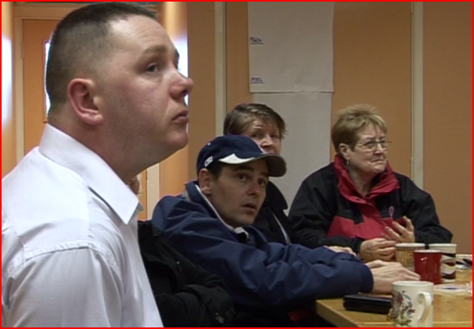
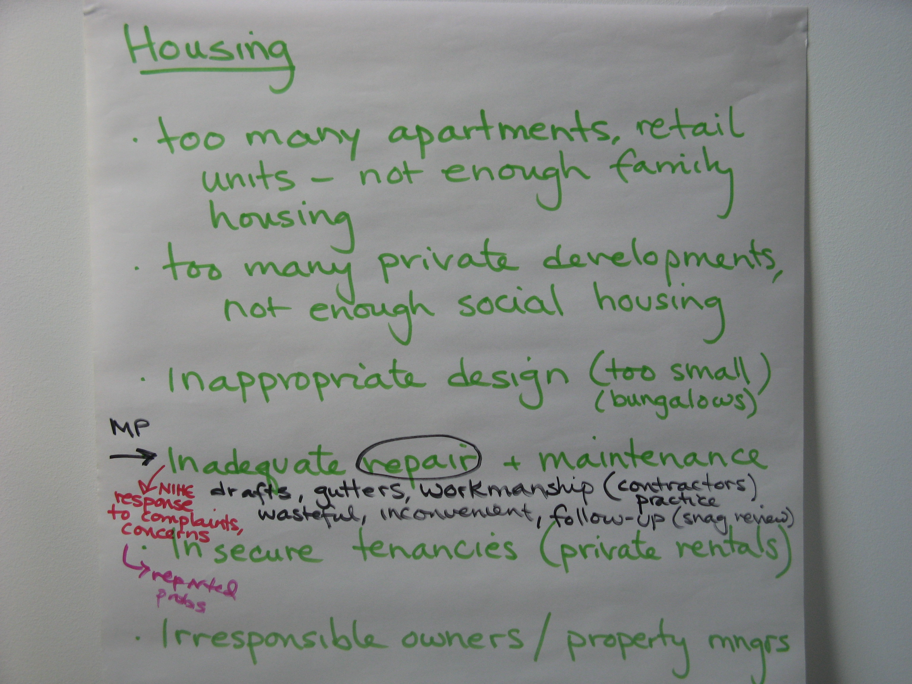
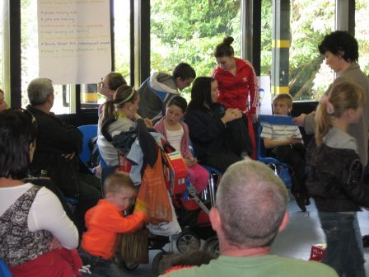
Organising
Notes:
To build participation – you must go to where residents are at.
Vital to the validity of the PPR’s rights based approach is that it is done by the affected group themselves. Our approach is not about advocacy – it about supporting and facilitating a marginalised group to use human rights to make change.
Through all our issues, we use a variety of organising strategies to bring together residents and groups to discuss their common issues.
Once a group is pulled together, we then put on a development programme – we call it ‘How Communities can use Rights.’
The development programme covers human rights, action research, campaigning strategies and so forth.
However the very first thing we do with a group is to ask them to list the issues that were impacting negatively on their lives. Some are big and some were small. It is critical that the approach is centred on the issues affecting the group as opposed to any preconcevied ideas about what anyone else thinks is best for them. This is critical in terms of setting the agenda and direction of the subsequent campaigns.
The RBA starts with the most marginalised. Their experience of unemployment, sub-standard housing and poor health is an expertise. They know first hand what is wrong with current services. They know the impact on their lives, the causes, and possible ways of addressing it.
This expertise is core to the success and validity of the approach. Particularly when you are working with the most excluded groups it is very important for them to set the agenda, if they are to have confidence in the process.

Slide 5
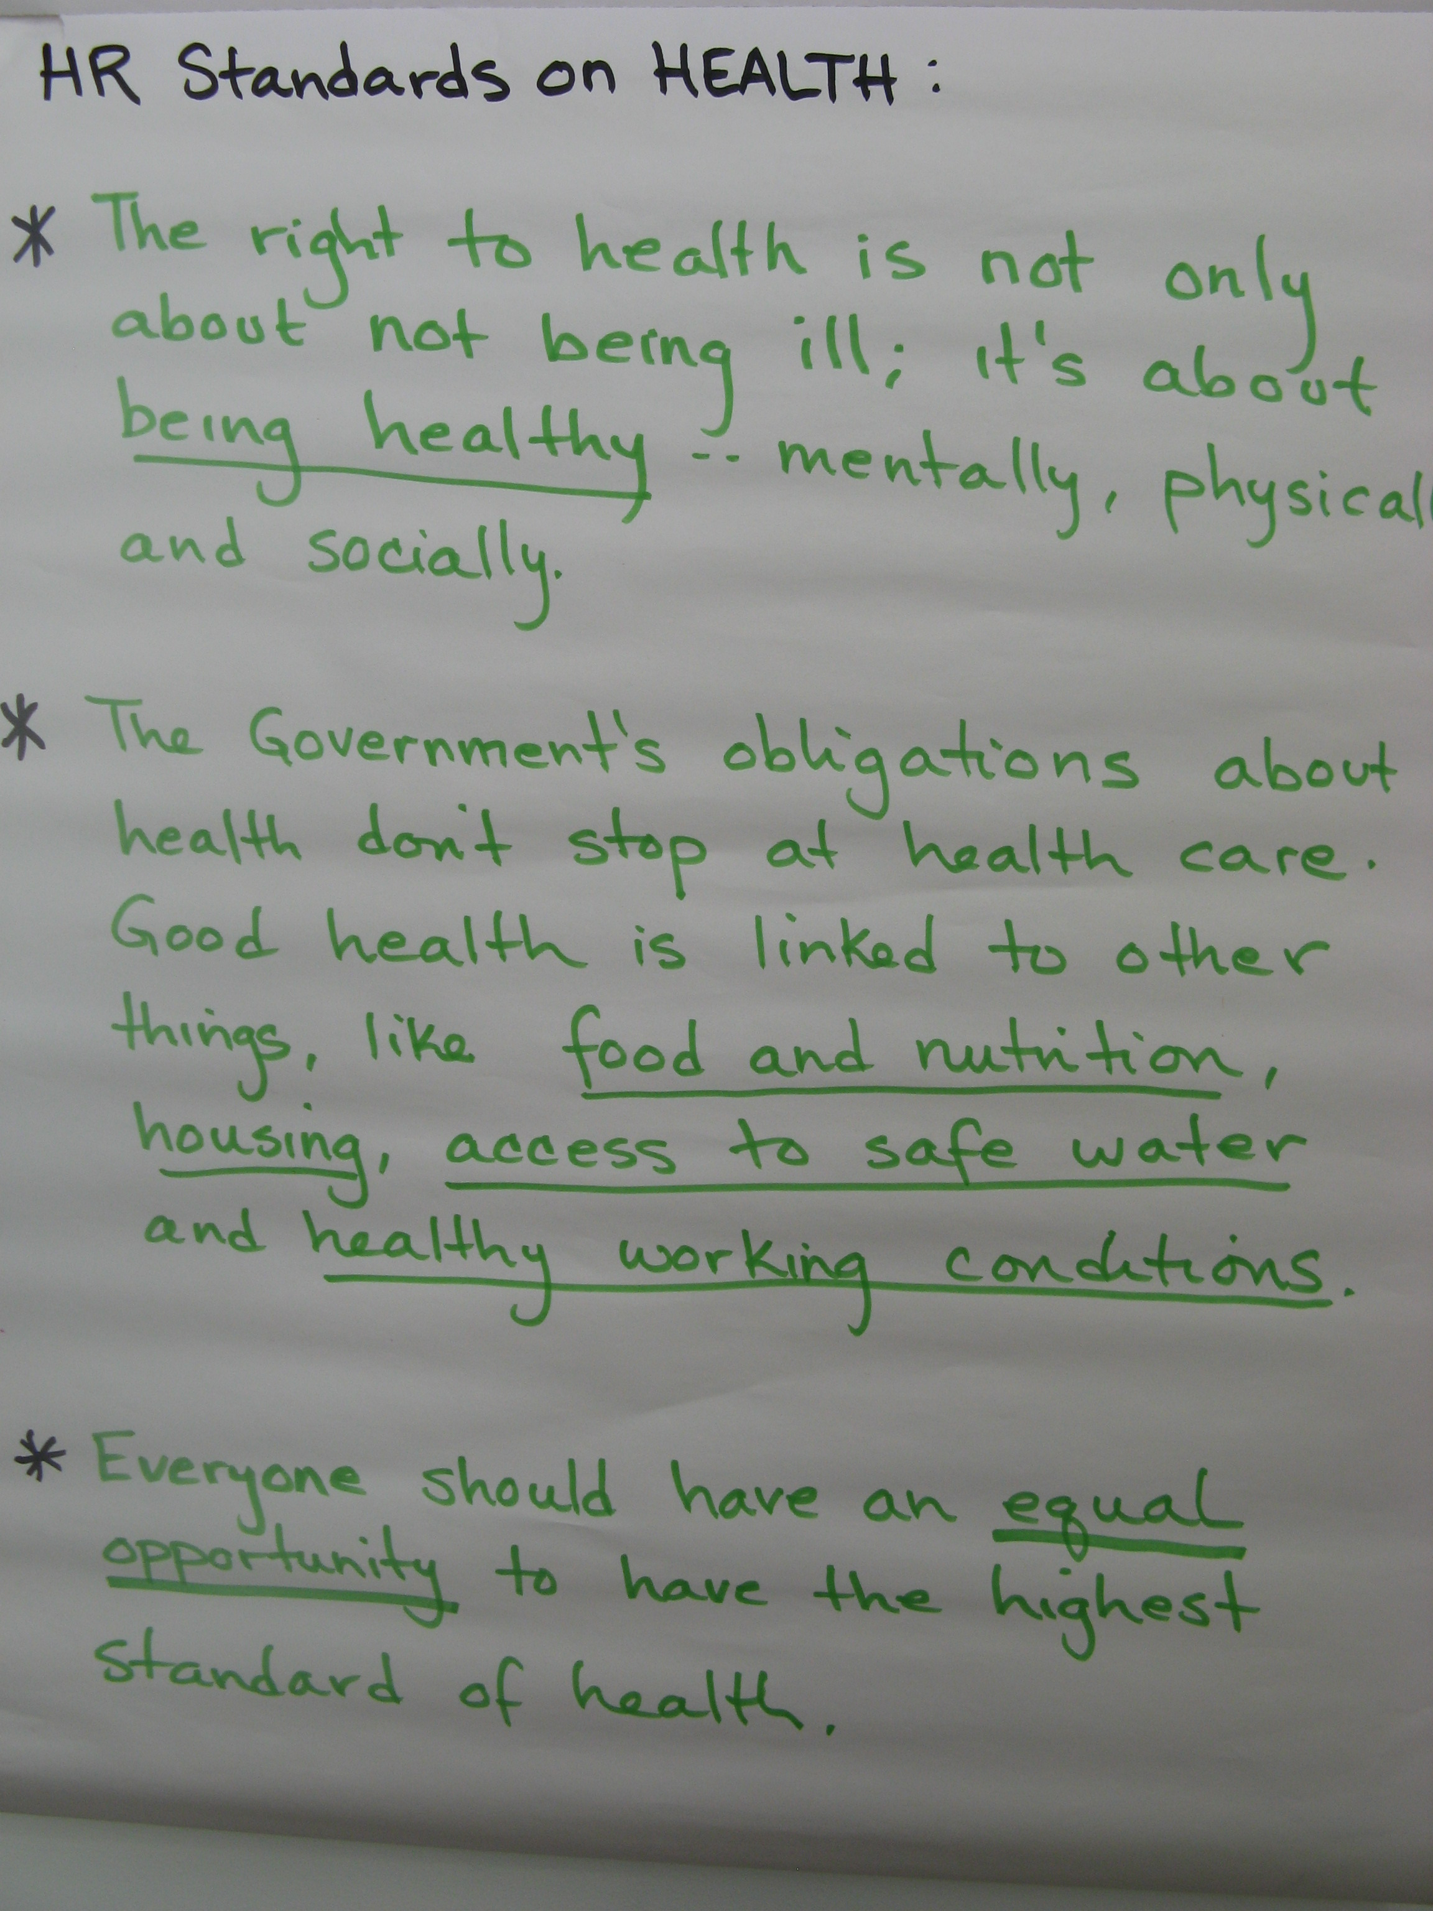
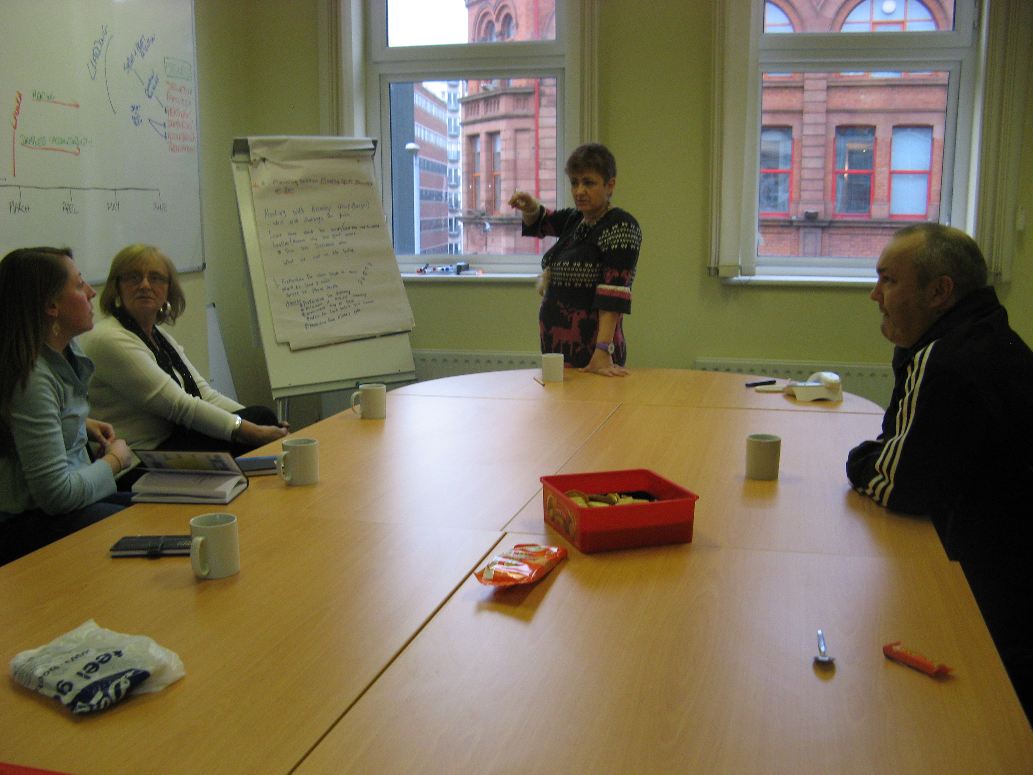
Building Knowledge
Notes:
Next step is deciding what issues to work on – what change the group knows is needed.
While residents come together to identify ‘issues’ – a ‘rights based approach’ is about specific human rights issues. Not all issues are human rights concerns or do not have a strong basis in human rights standards. So the next phase of development is to go through a process of education with residents about how human rights relate to their issues.
This helps the groups to choose issues which are genuine human rights issues. This in turn enables them to demand from government that the standards they have signed up to at an international level relating to these issues are put into practice.
However, in putting pressure on the government, the group have to think about who to target.
Very often a large number of public agencies can be identified who have some sort of responsibility for their issues.
Human Rights Based Approach gives direction on this.
PPR works with the groups ensure their campaign and approach is targeted at the highest authority for their issues.
In practical terms, this means the relevant government Minister who has ultimate responsibility for housing, or health.
While service delivery bodies such as the Housing Executive or Council also have responsibility, it is the Minister who has been elected by the people, and is part of the government which signed up to international human rights commitments.
Because of this it is the Minister who has final responsibility in terms of human rights.

Slide 6
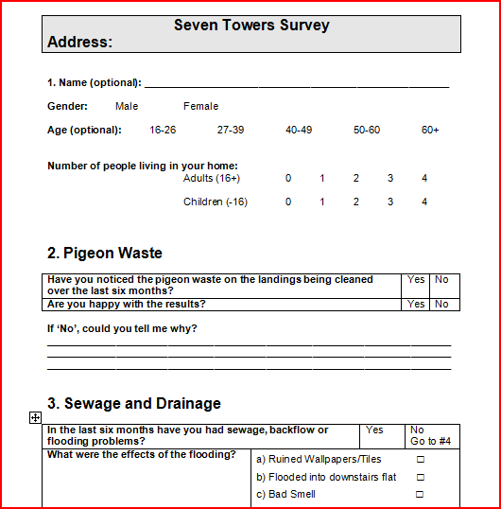
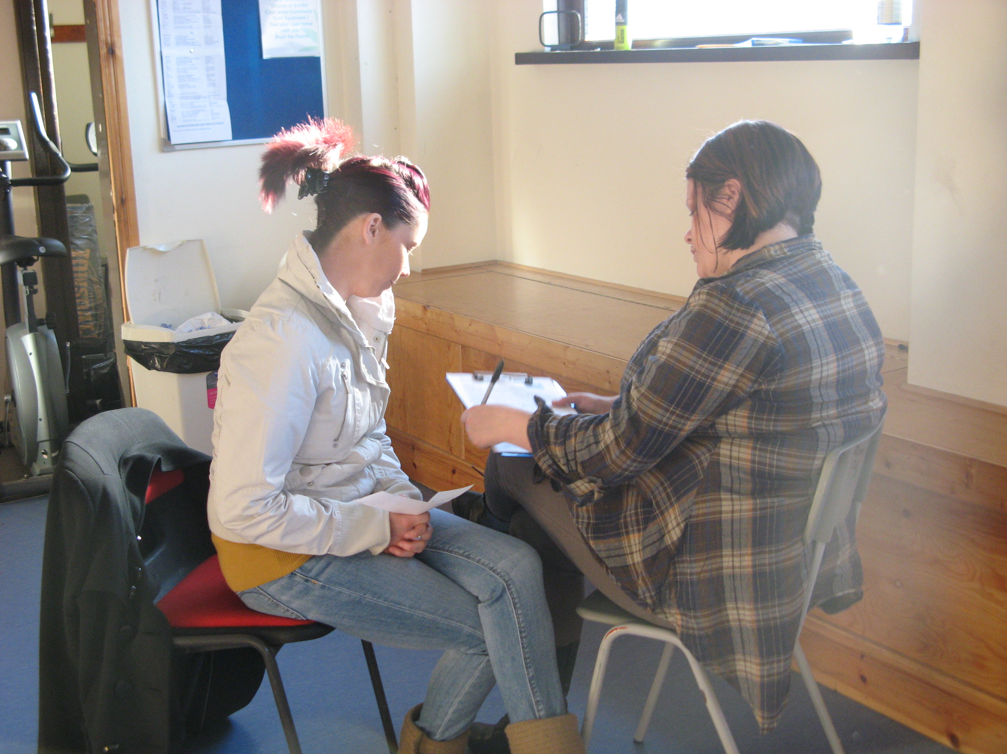
Gathering evidence – what is the extent of the
problem?
Notes:
Once residents have identified their human rights issues, know what their rights are and what government should be doing about them, they need to establish the extent of the potential human rights abuse in their community.
To do this, residents need to talk with other people experiencing the problems. PPR support the residents to do this through action research: photography, surveys, focus groups, etc.
This fulfils two important purposes for participation
It gives value and gives weight to the expertise of the people experiencing the problem
It also does what we call ‘setting a baseline’
This action research enables residents to get a statistical snapshot of the problem in their community.
Once they have done this, the group now know the extent of the problem at a given time.
Once residents have identified their human rights issues, know what their rights are and what government should be doing about them, they then need to establish the extent of the potential human rights abuse among their community.
To do this, residents need to talk with people experiencing the problems. PPR and residents have done this through action research:
Photography & check list - Shankill Glass & 7T pigeon waste
Surveys – 7 Towers
Focus Groups – BMHRG
This fulfils two important purposes for participation:
it values and gives weight to the expertise of the people experiencing the problem.
- but it also does what we call ‘setting a baseline’.
This action research enables residents to get a statistical snapshot of the problem in their community.
Once they have this, the group now know the extent of the problem at a given time.

Slide 7
Why measure change?
Under human rights law, government are under an
obligation to ensure that things improve.
Baseline = where we’re at now
Indicators = issue want to see addressed
Benchmarks = targets

Slide 8
MAINTENANCE
Drainage & Sewage
International Human Rights Standards
“An adequate house must contain certain facilities essential for health including…sanitation, site drainage.”
CESCR General Comment 4, Paragraph 8 (b)
Northern Ireland Housing Executive Responsibility
According to the Northern Ireland Housing Rights Service booklet ‘Repairs in Social Housing’ sewage ingress is classed as an ‘emergency repair’, which should be carried out within 24 hours.
Blocked drains are classed as ‘urgent repairs’ , which should be carried out within 4 working days.
Baseline
In April 2007 61% of residents reported problems with blocked drains and sewage.
Notes:
CLICK THROUGH

Slide 9
MAINTENANCE
Drainage & Sewage
Indicator
% of residents reporting drainage and sewage problems
Baseline
In April 2007 61% of residents reported problems with blocked drains and sewage.
April 2007
61% of residents with drainage & sewage problems
November 2007
30% of residents with drainage & sewage problems
BENCHMARKS
3% of residents with drainage & sewage problems
May 2008

Slide 10
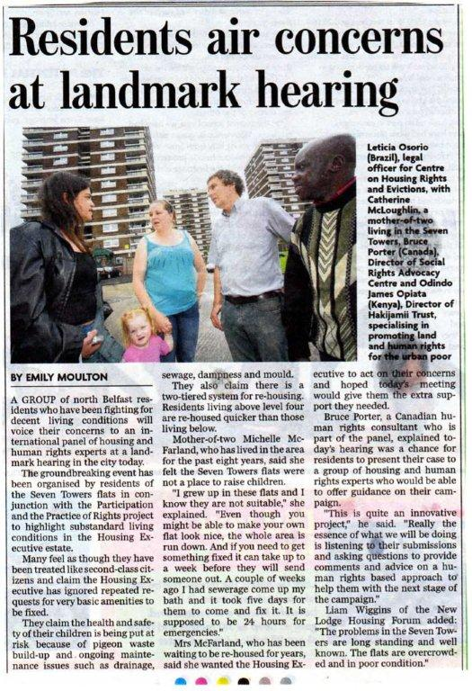
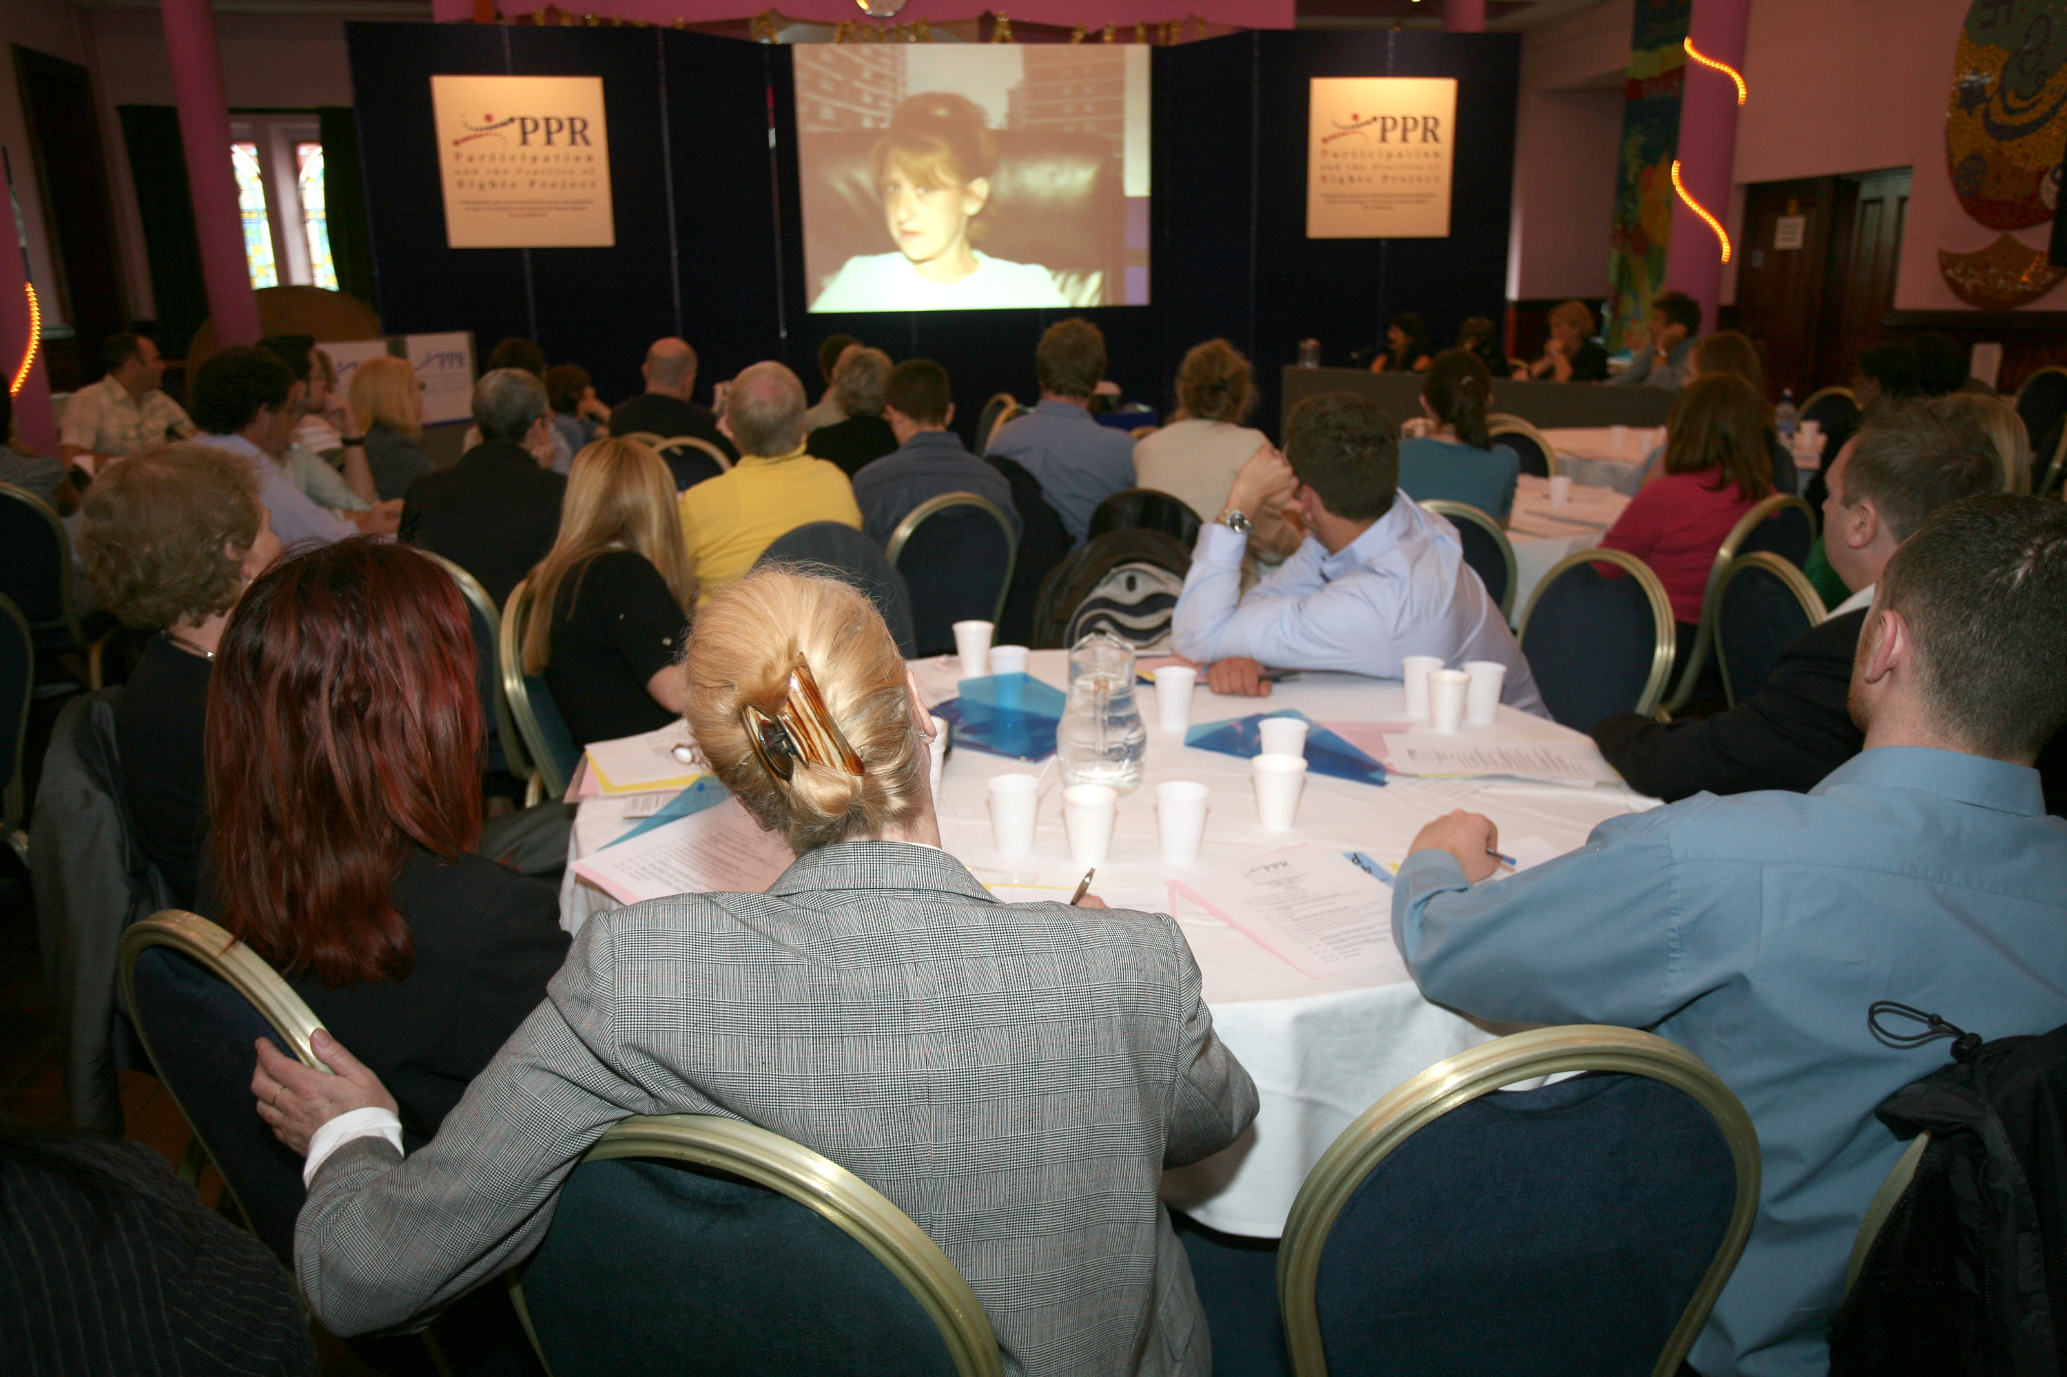
Launching the Campaign
Notes:
Prior to going to government or the public body responsible with their issues, the PPR groups have held a public event, such as a hearing.
This enables them to show the work they have done, their surveys and evidence. It lets them publicly frame their issues as human rights issues, and by putting their work out there, they can start to build alliances with other groups, with human rights organisations, academics and international people working in the same field.
Press strategy has also been important. The groups have also effectively used the media to highlight their issues. Can see a press clipping here, but groups have also spoken on the radio and appeared on TV to highlight their issues.
What these events clearly show is that the approach has international validation and support. Groups develop allies in different fields who validate the case they have built with evidence and surveys etc. The aim is to get government to do what it is supposed to.
Prior to going to government or the public body responsible with their issues, the PPR groups have held a public event, such as a hearing.
This enables them to show the work they have done, their surveys and evidence. It lets them publicly frame their issues as human rights issues, and by putting their work out there, they can start to build alliances with other groups, with human rights organisations, academics and international people working in the same field.
Press strategy has also been important. The groups have also effectively used the media to highlight their issues. Can see a press clipping here, but groups have also spoken on the radio and appeared on TV to highlight their issues.
What these events clearly show is that the approach has international validation and support. Groups develop allies in different fields who validate the case they have built with evidence and surveys etc. The aim is to get government to do what it is supposed to.

Slide 11
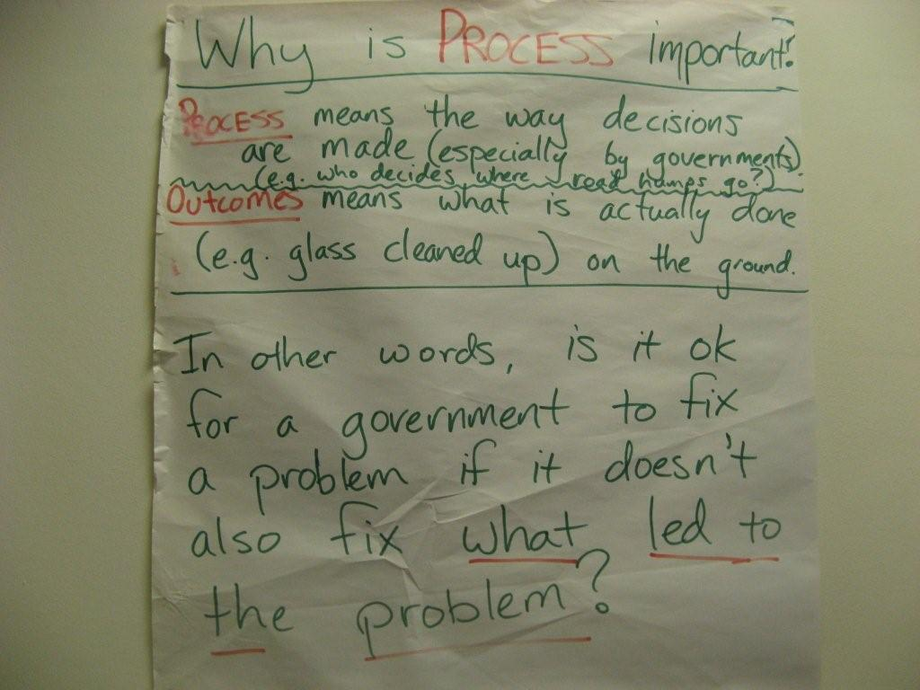
Participation is the starting point…
…and is the desired outcome of the Human Rights Based Approach
Notes:
All the groups monitor the participation of people like them in decision making, alongside their other issues.
Flipchart above: ‘Is it ok for a government to fix a problem…’. Groups focused on changing how decisions were made as well as the results of these decisions.
This is where the human rights based approach provides further tools. It contains global standards on participation, accountability and equality which define what the decision making relationship between the government and individuals should look like.
Because the groups realise that conditions and issues that affect them, are the result of ineffective decision making that has excluded them, and resulted in years of poor outcomes.
Improving this is vital to alter the power relationship.
This approach would also have the benefit of ensuring that the changes they made lasted and were felt by other groups.
Changing the way a public body made it’s decisions would mean the changes weren’t just local to one area but that other housing or health groups could benefit.

Slide 12
Outcomes on the Ground
A £900,000 investment by the Northern Ireland Housing into a local high rise flats (Seven Towers, North Belfast) to install a new sewage system
The removal of pigeon waste from the landings of residents’ homes in Seven Towers which accumulated over years, exacerbating asthma in children who lived there and creating mite infestation, and was never cleaned. As a result of PPR’s work a regular cleansing system was put in place
Achieved a review of the proposed £7 million scheme to invest in the Seven Towers flats which did not address residents’ needs. An improved tender was re-issued.
Secured the re-housing of 60 families with small children out of the Seven Towers flats into more appropriate accommodation
Since 2010, approximately 160 people in mental health crisis per month presenting themselves to A&E have received assessments and an entry point into mental health services as a result of the Card Before You Leave scheme which was secured by the Belfast Mental Health rights Group
Secured the opening of a local youth centre in the Lower Shankill from one night a week to five nights a week.
Chairing the Lower Shankill Regeneration Board, and directing the campaign, PPR secured first social housing to be built in the area in over 20 years (39 units).

Slide 13
Outcomes in Policy Change
Improvements made to the Belfast Trust’s Serious Adverse Incident Review procedure allowing families to make their own record of meetings, the creation of a user-friendly information pack on the process for families, and the appointment of a Family Liaison Officer to support bereaved family members.
Campaigned for the first ever Equality Impact Assessment being carried out on an urban regeneration scheme, the £231m Girdwood Barracks and Crumlin Raod Gaol project
Successfully lobbied the UN Committee on Economic, Social and Cultural Rights (UNCESCR) to include specific Concluding Observations to the UK government on Catholic housing inequality in Northern Ireland, urban regeneration and mental health
Achieved the withdrawal of a regeneration plan in the Lower Shankill (West Belfast) and its redevelopment with the full participation of residents and secured a cross-sectoral working group to bring forward new regeneration plans, including Ministerial commitment to work on ground-breaking employment clauses in the procurement contracts.
Formally advised the minister for Culture, Arts and Leisure on the incorporation of groundbreaking ‘equality clauses’ into £42m of government procurement contracts to provide real jobs and apprenticeships for the long-term unemployed

Slide 14
Applying Human Rights in Practice brings...
Changes in relationships
Resistance to change, and response of power
Constant organising
Focus on implementation on the ground, not just change in a policy document
Dignity and empowerment arising from people putting rights standards into practice
Notes:
Changes in relationships – duty-bearer
Brings into sharp focus the power relationships – the difference in power between goverment officials/decision-makers and an affected group. Always needs to be borne in mind – constantly building power of group on the ground to apply pressure for change
Resistance to change
Decision-makers are quite resistant to being held to account, particularly by a group of ‘ordinary’ people. 1st response from decision-makers is often about alleviating the pressure they are under – not about fulfilling the right. Worked within decision-mkaing boards to ensure they work in line with human rights standards, and participate meaningfully e.e. Minutes delivered on time, no jargon – heavily resistant. Changing the way of doing business
Organising – people impacted by the issue they are campaigning on. Times they won’t be able to do this – due to challenges in lives. Constant organising is very important and gives a wider group of people the chance to be involved.
Implementation – neighbours tell them if it is working or not. CBYL, real Jobs now motion. Need timetable for change – that’s what indicators and benchmarks are about.
Dignity
Used to seeing lack of change and disinterest – deserve no better. Problem not you, you have a right to better, but there has been a failure of others to act on it – galvanising....

Slide 15
“Across the island of Ireland, indeed across the globe, people are increasingly demanding ‘healthy’ democratic participation within the state. This is not some abstract political concept; it is about ensuring public decisions are taken on the basis of transparency, accountability and participation. It applies to 'big' questions like national taxation policies as much as it does, for example, to 'narrow' issues faced in the daily lives of residents from the Seven Towers here in Belfast asserting their right to adequate housing.
This type of ‘healthy’ relationship with the state is the basis for a sustainable democratic and economic fabric tomorrow. Its absence today is the promise that yesterday’s failures will be repeated tomorrow.”
Mary Robinson, Amnesty International 50th Anniversary Conference, Belfast
Notes:
Vital to see holding government to account and campaigning for rights is not ‘bolshy’ or obstreperous.
Rights have always been shaped and formed as a result of a group of people/expereinces saying the ‘status quo’ is not taking account of me – campaigns, legal cases
This creates tension, but it’s a healthy tension, which represents what healthy democracy is all about ‘ensuring public decisions are taken on the basis of transparency, accountability and participation’, and ensuring it leads to outcomes for the most marginalised.

Slide 16
nicola@pprproject.org
www.pprproject.org
www.facebook.com/PPRProject
@PPR_Org

